Slide 1
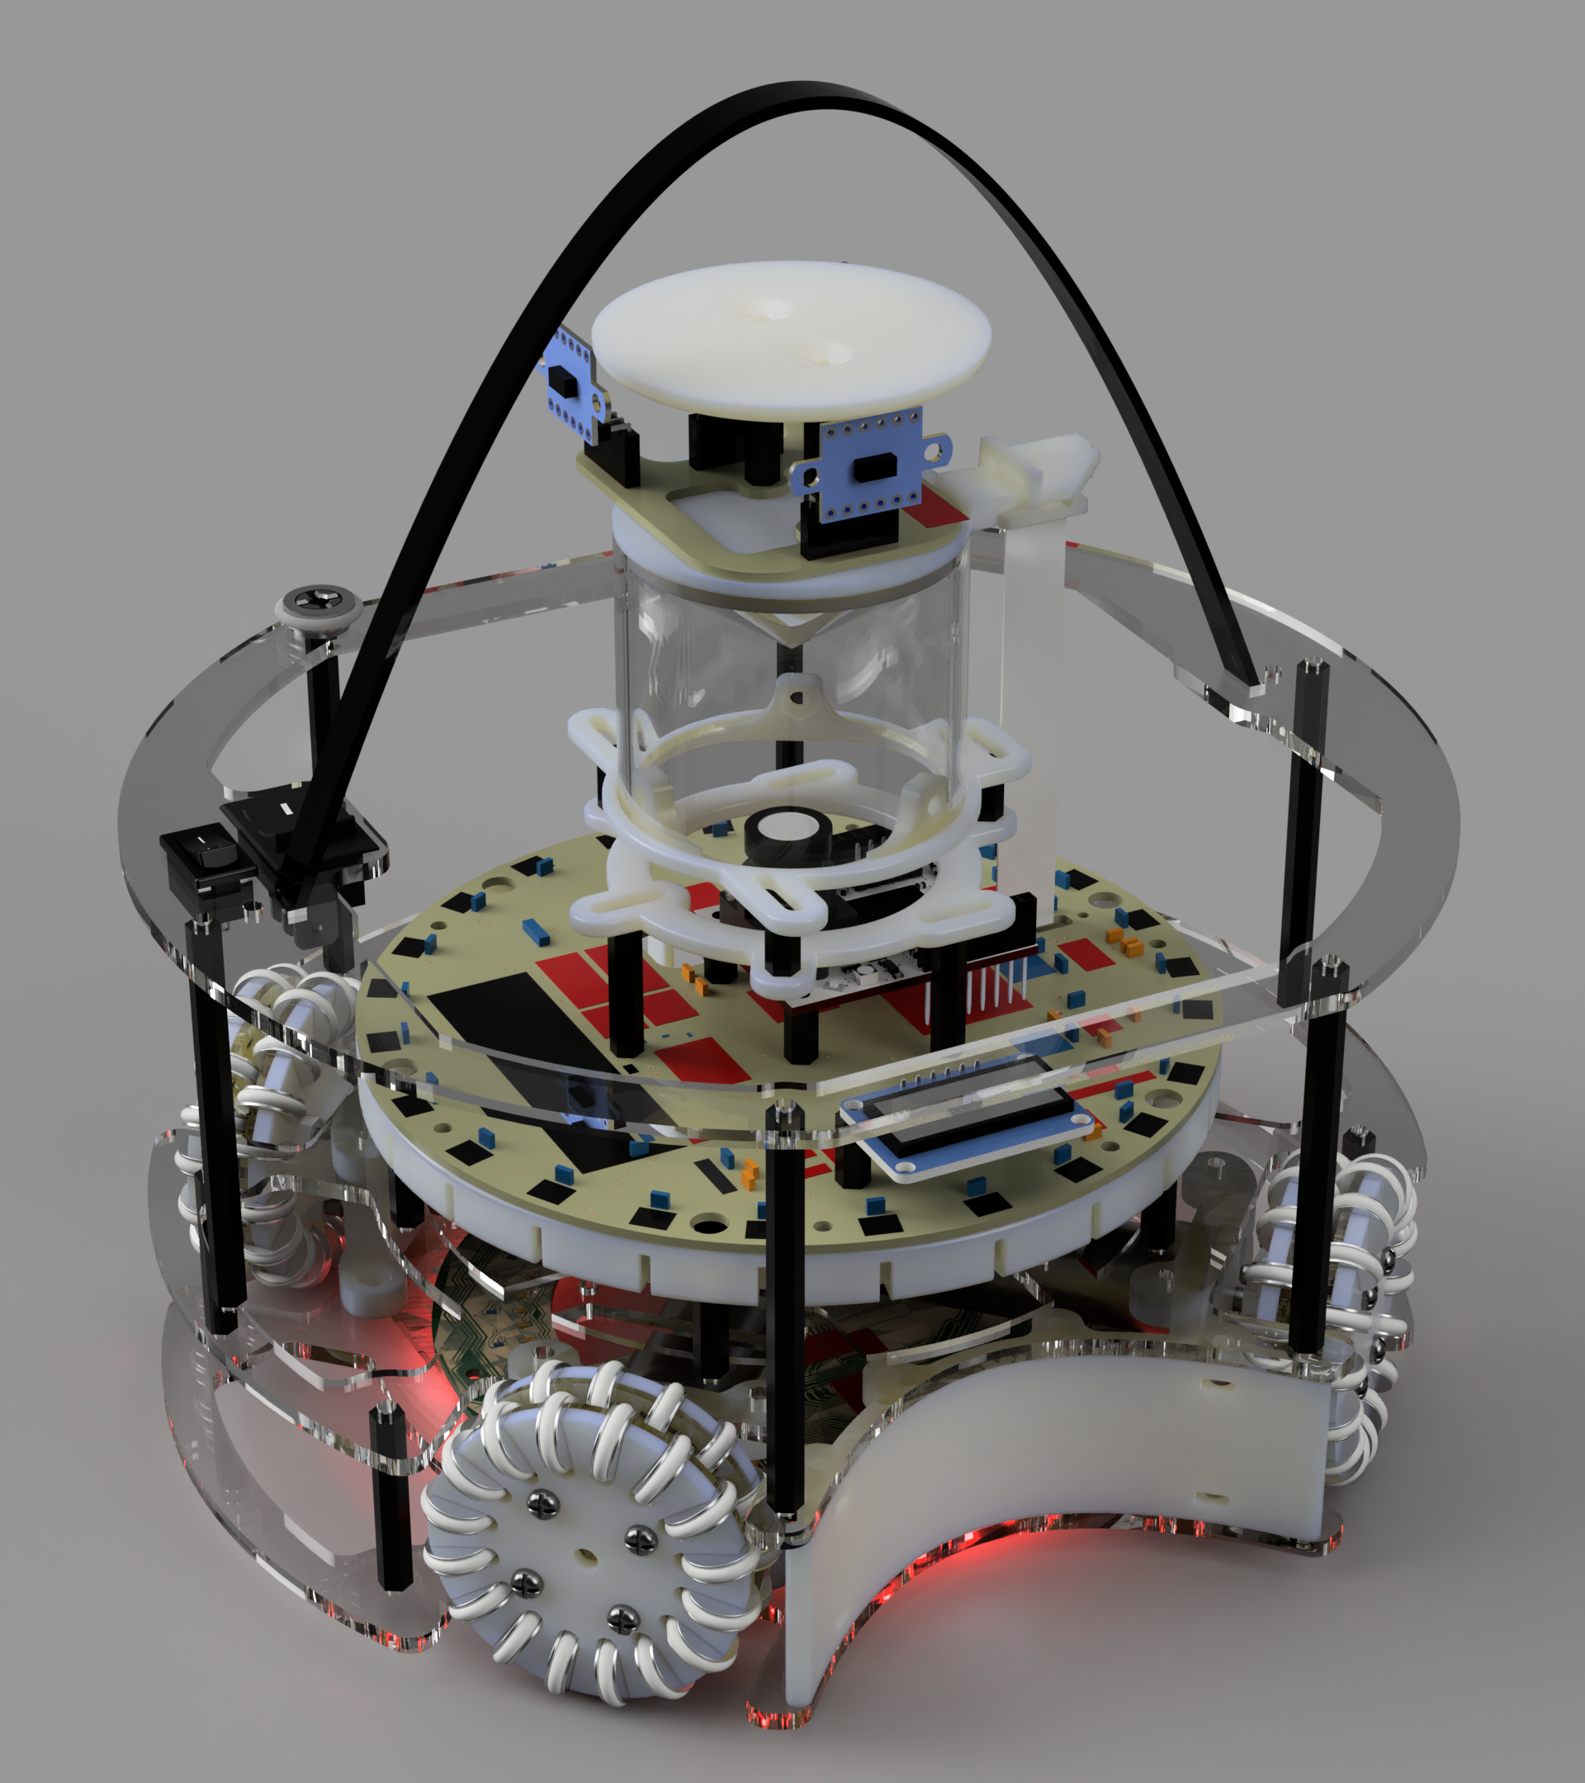
Gamma
BRISBANE BOYS’ COLLEGE
JUNIOR LIGHTWEIGHT SOCCER
Notes:
Aparaj

Slide 2
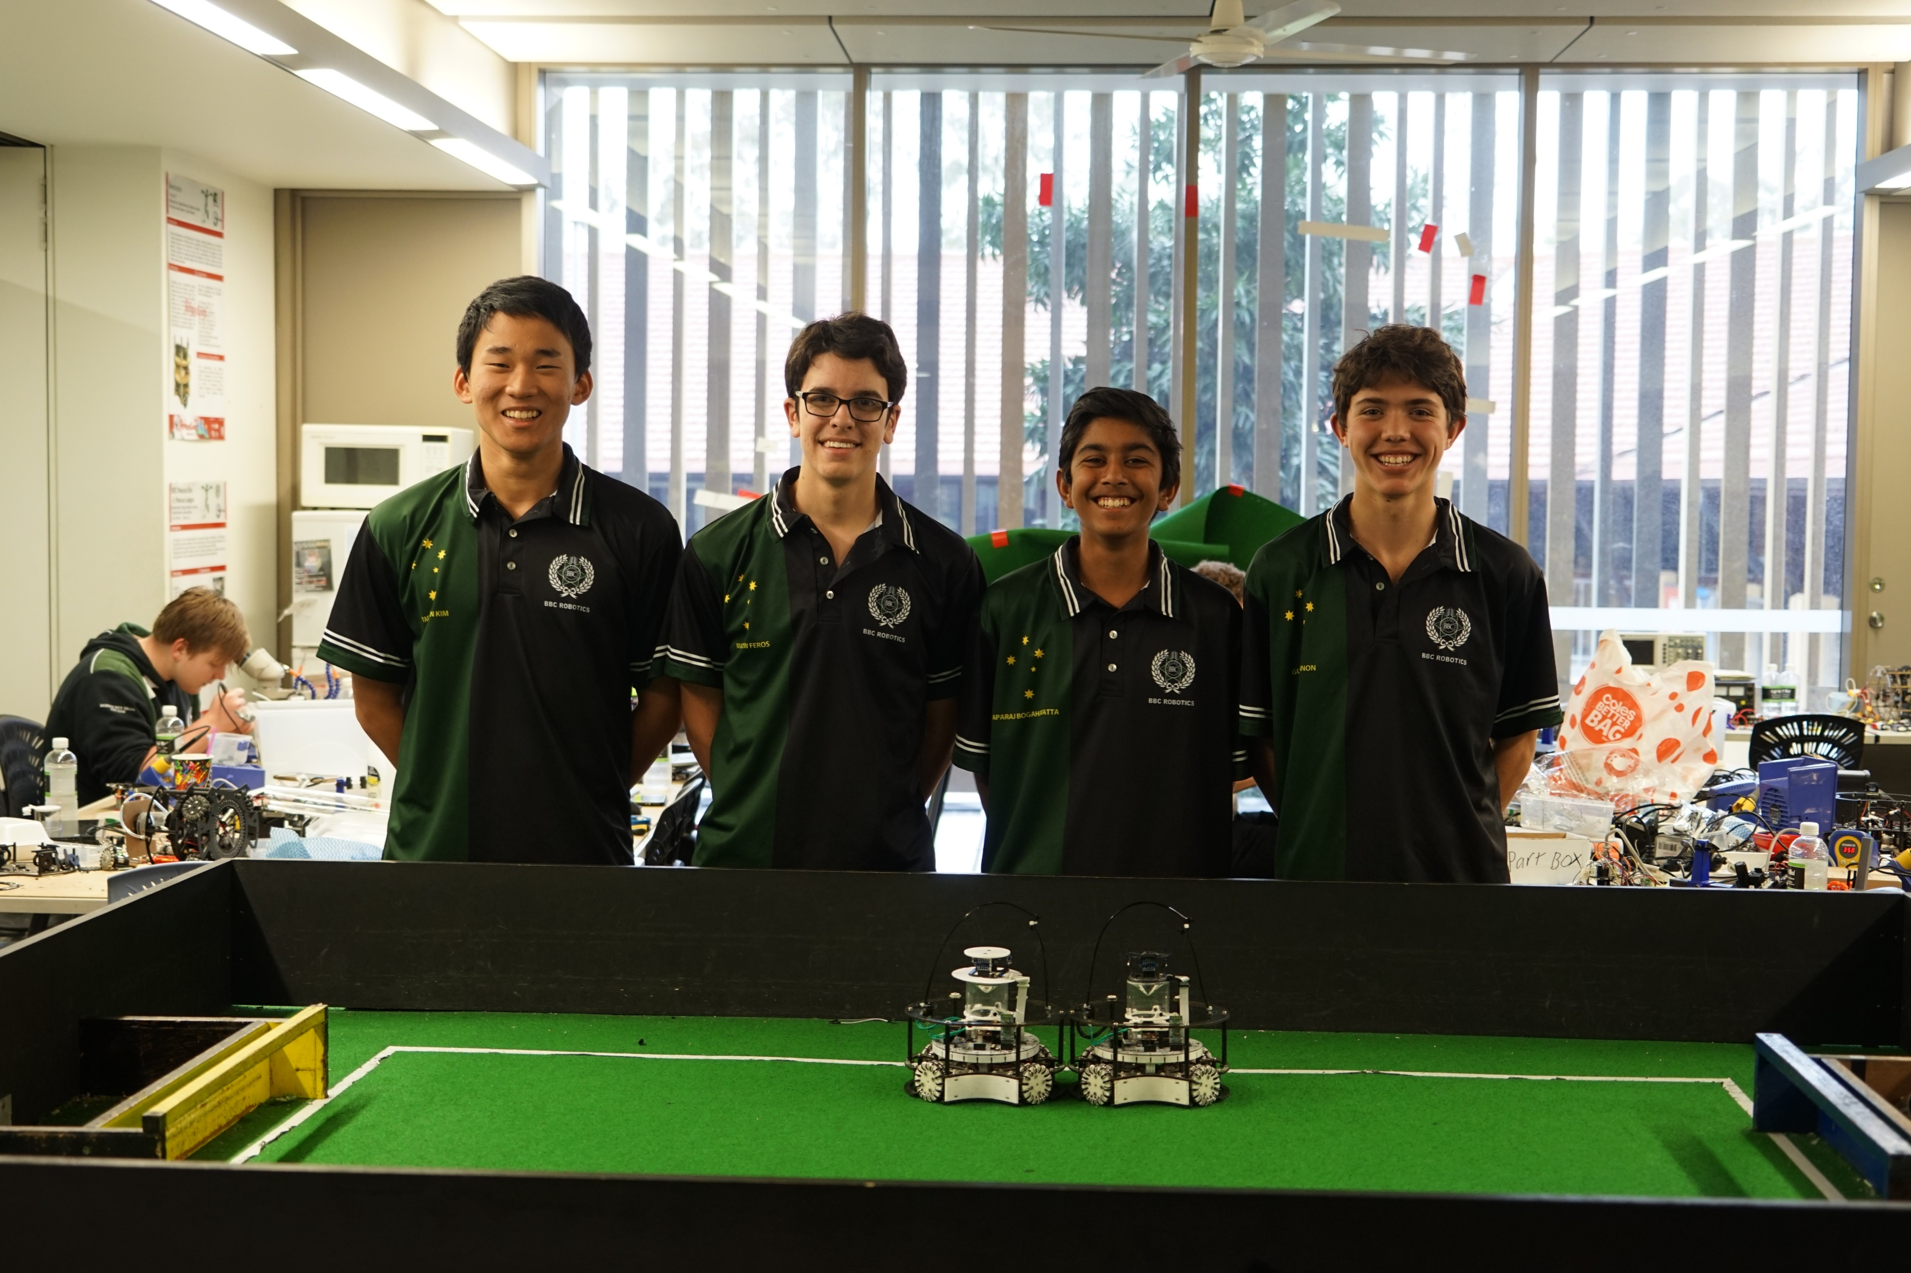


Team Structure
Taehwan Kim
Primary Documentation Developer
Tertiary Hardware Developer
Matthew Feros
Primary Electronics Developer
Secondary Hardware Developer
Primary Website Developer
Aparaj Bogahawatta
Primary Software Developer
Primary Robot Strategy Developer
Primary Poster and Presentation Developer
Gus Gannon
Primary Hardware Developer
Secondary Electronics Developer
Secondary Documentation Developer
Notes:
Aparaj

Slide 3
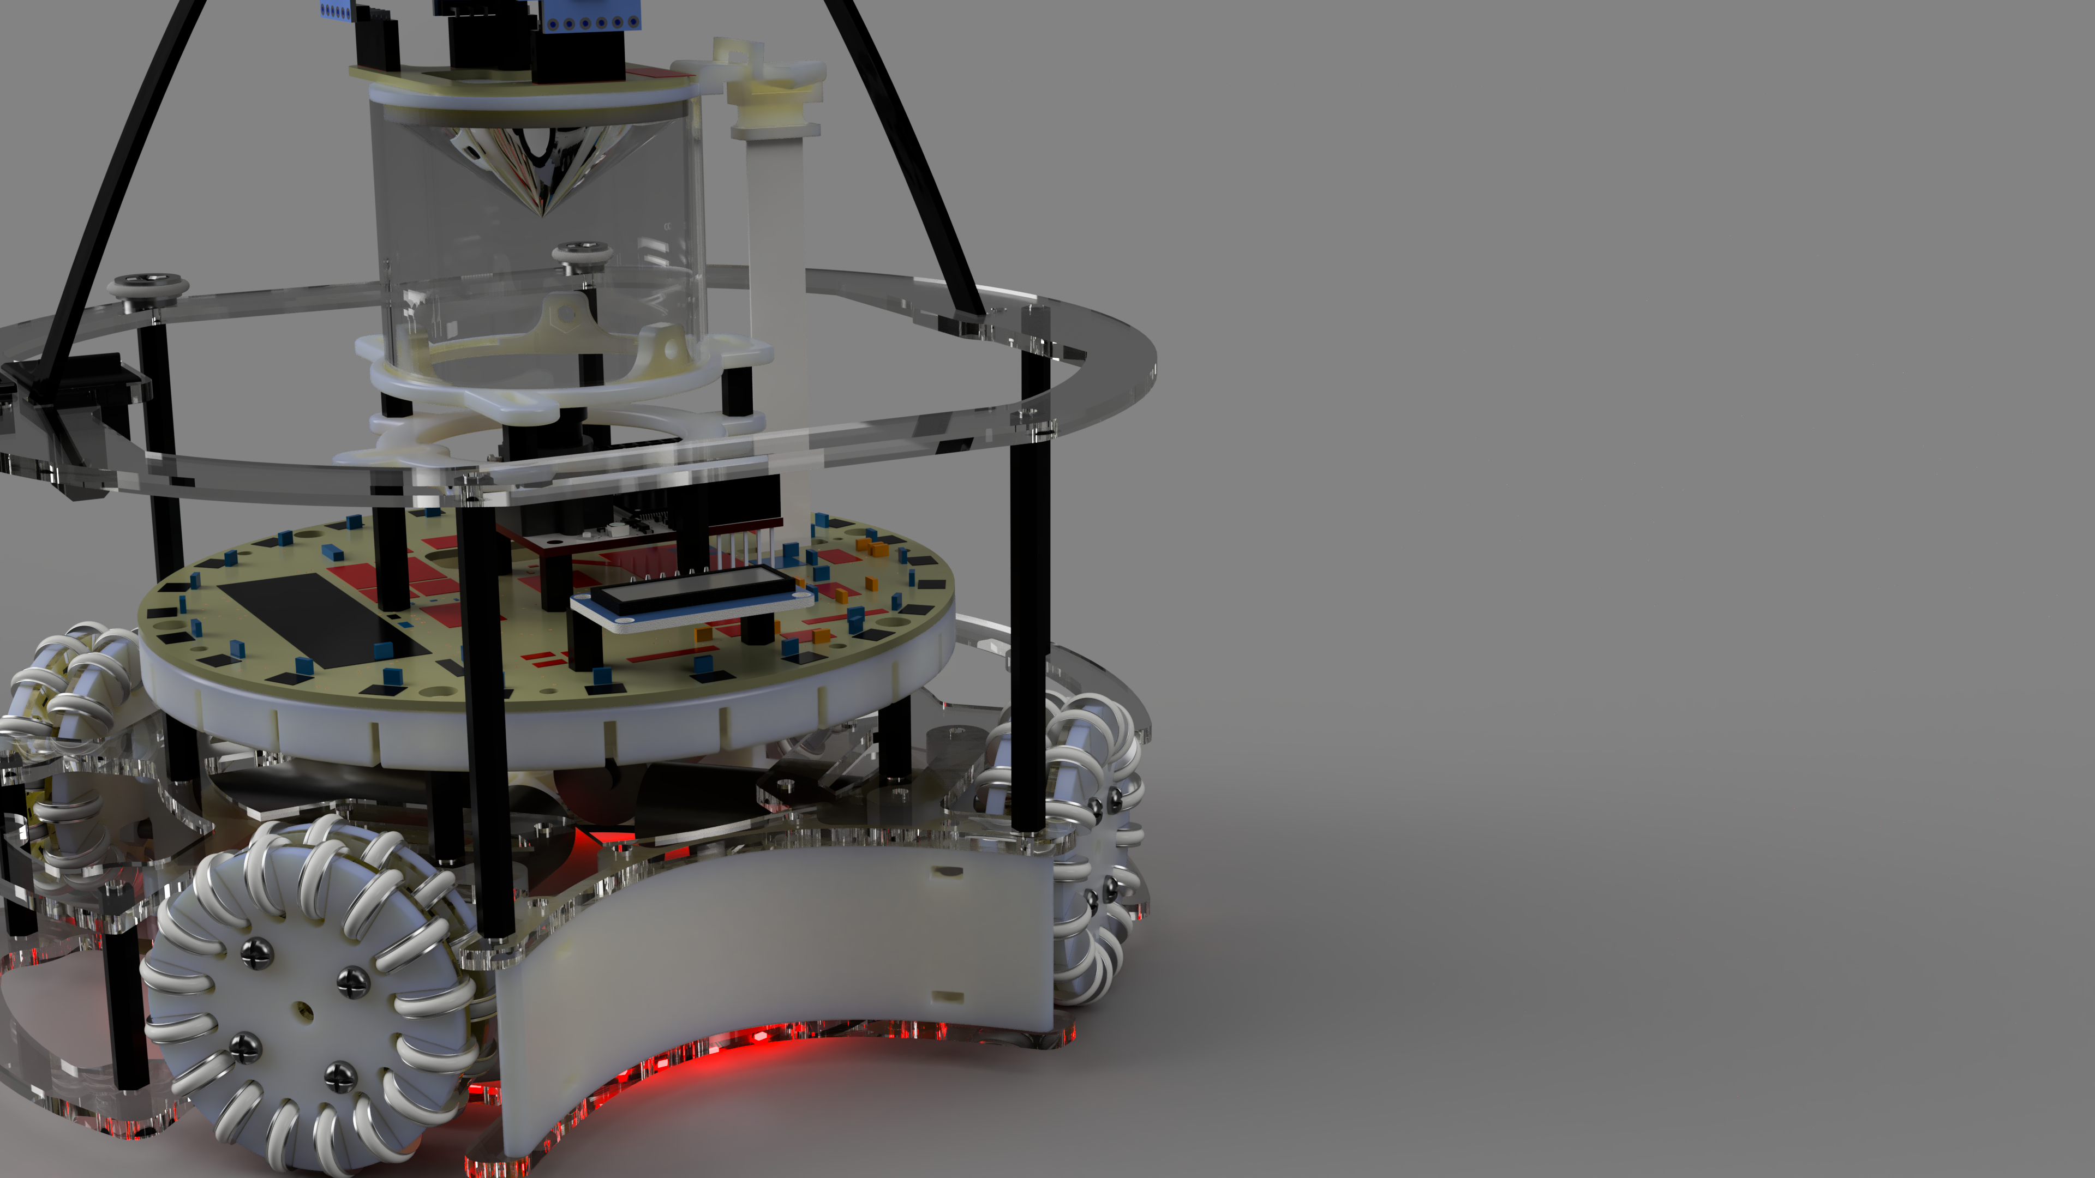
Chassis Design
Notes:
Gus

Slide 4
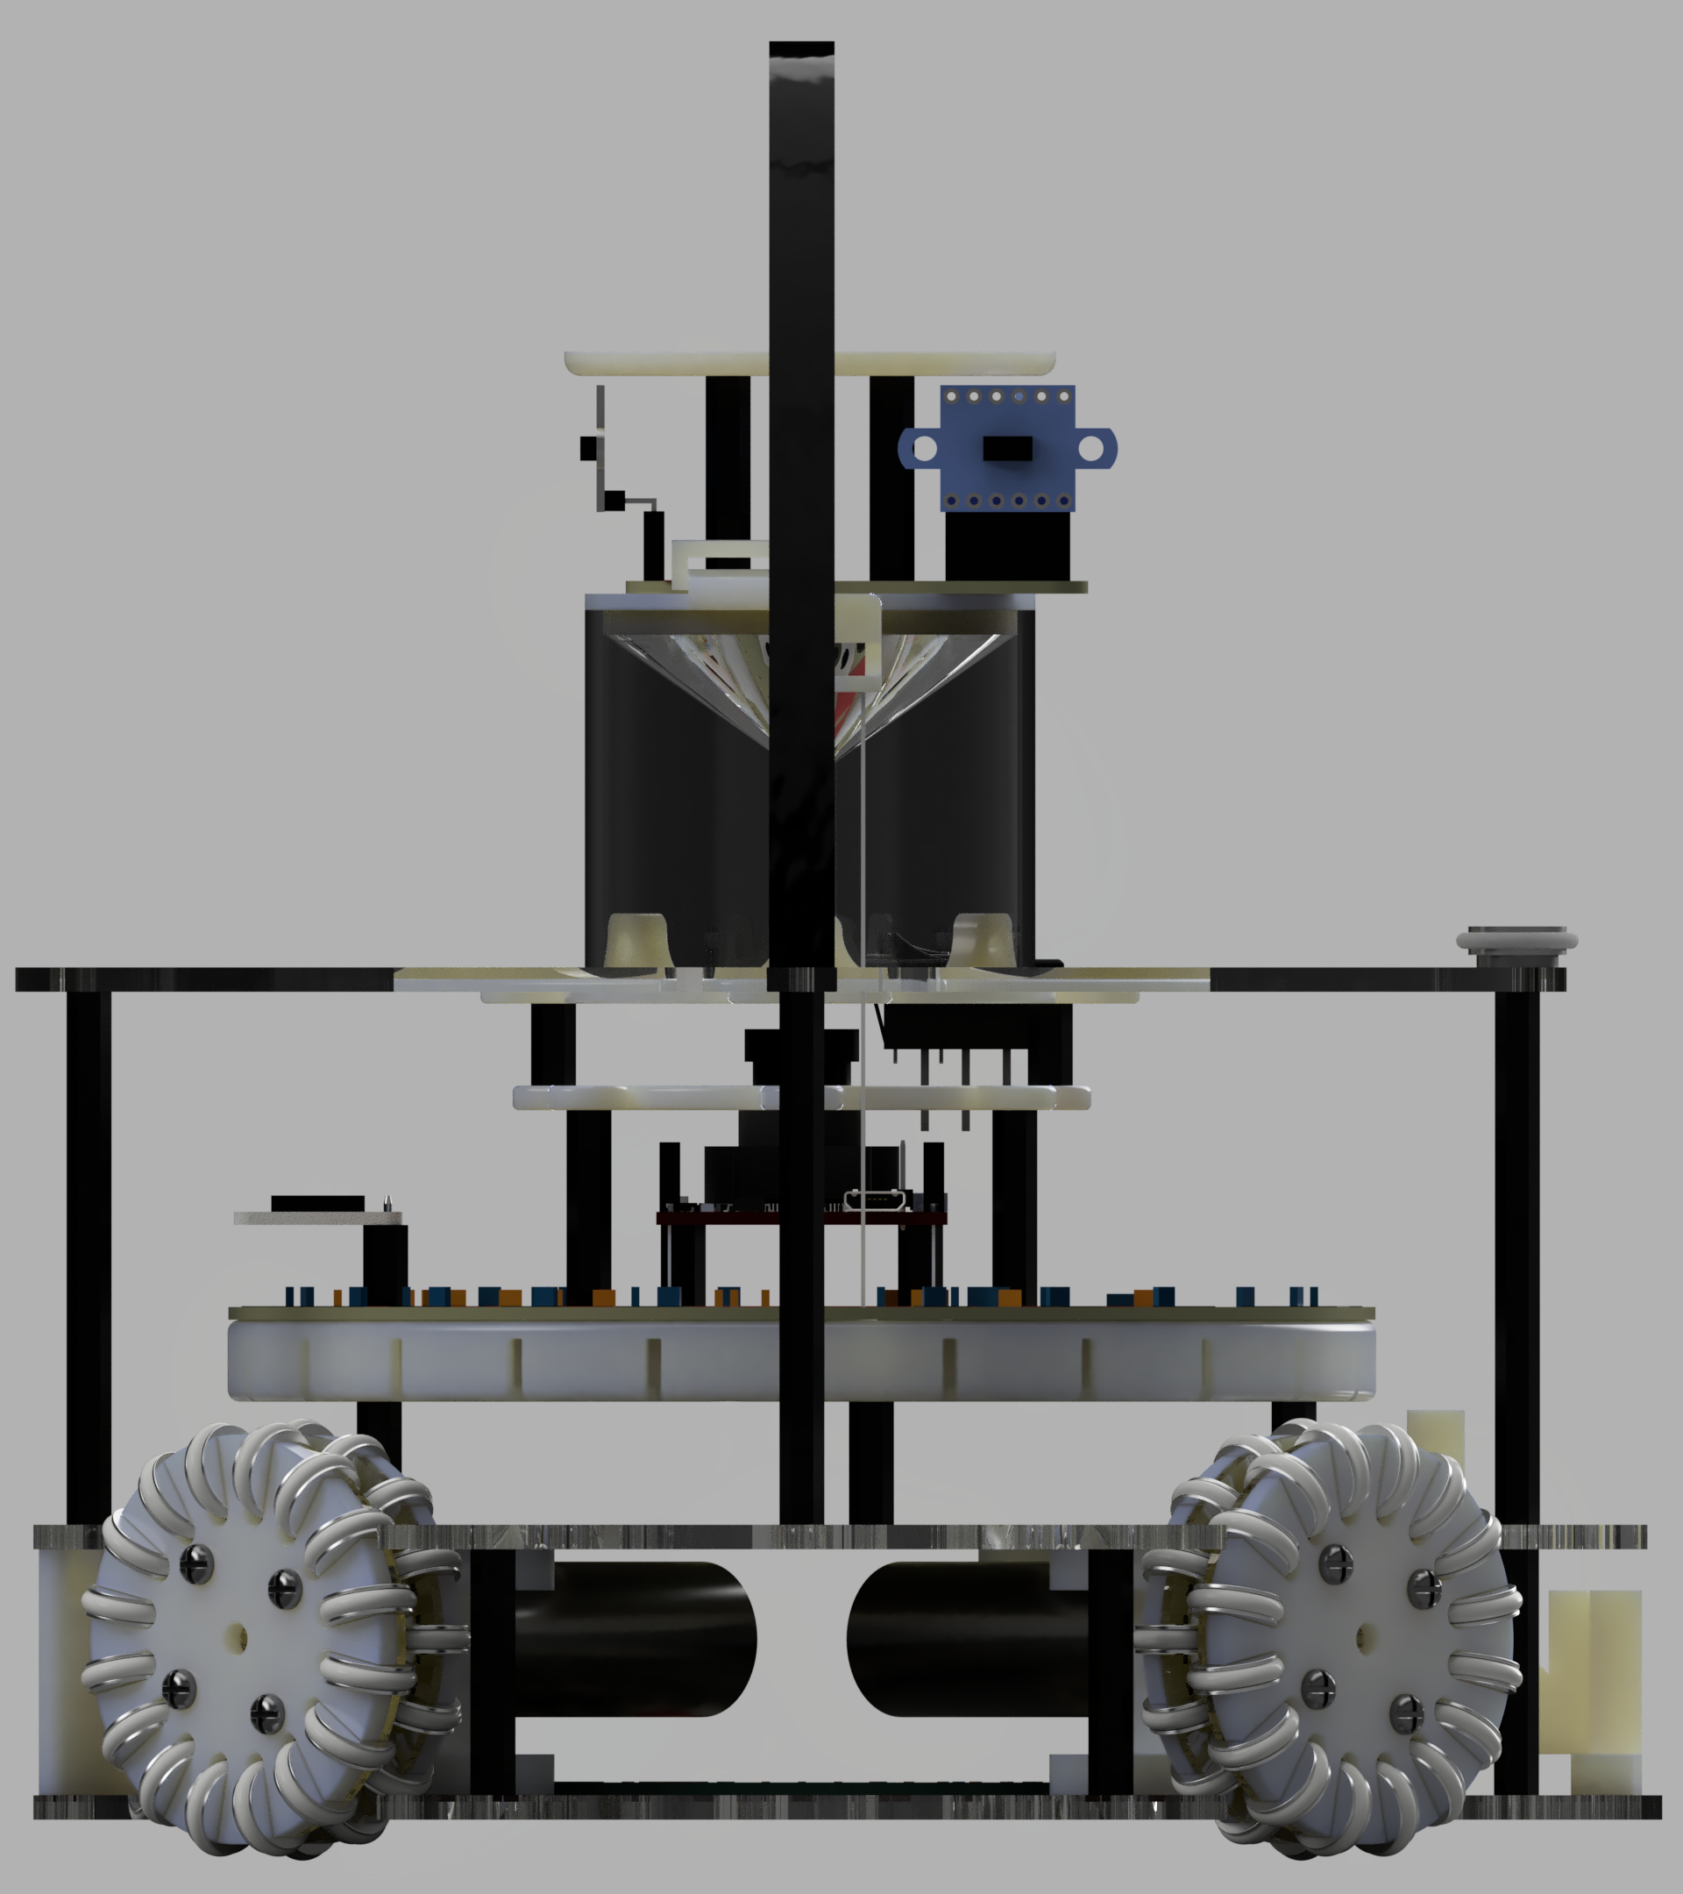
Overview
Use of Autodesk Fusion 360 for Structural Design
Use of Autodesk EAGLE for Electrical Design
Camera Cap:
-360° Mirror cone
-4 x Laser range finder
-Sticker plate
Top Layer:
-Cross bar bearings
-Handle
Main Circuit Board:
-Microcontrollers
-Screen
-IMU
-Camera
-Motor Controllers
-Power Supply
Middle Layer:
-Motor brackets
-TSSP sensor bracket
-Top plate supports
Bottom Layer:
-Light sensors
-Motor brackets
-Battery holder
Notes:
Taehwan

Slide 5
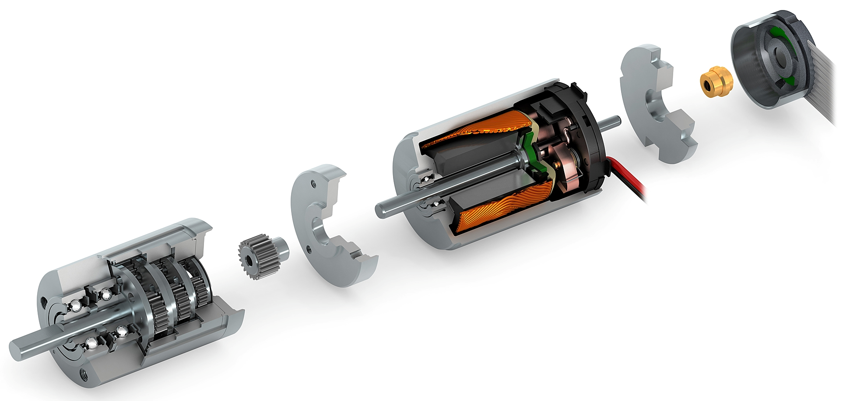
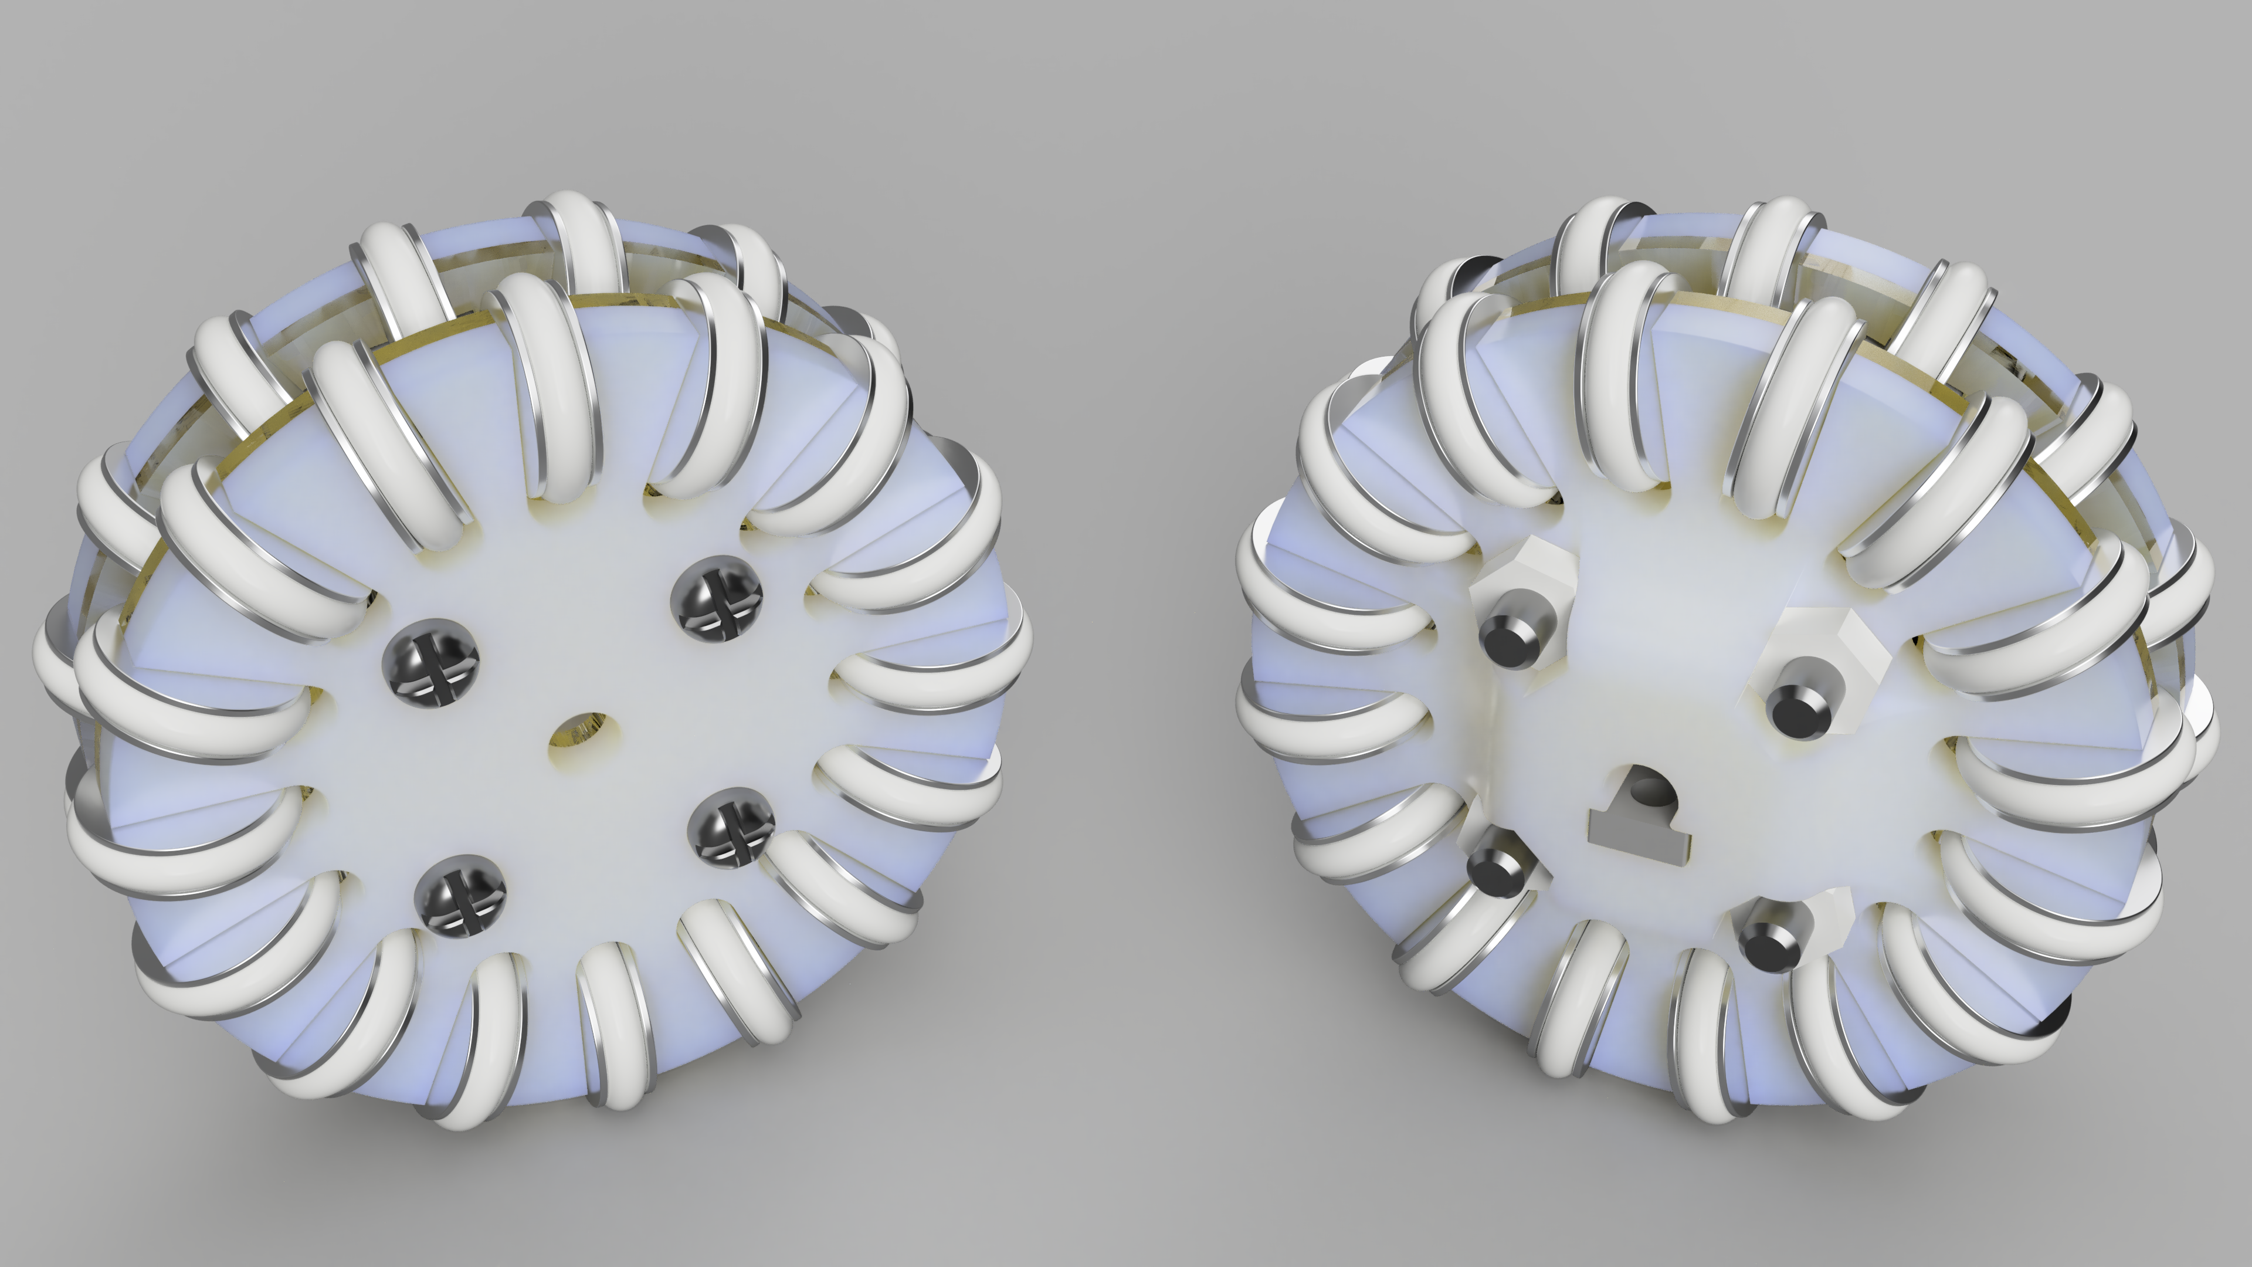

Drive System
9v Maxon DCX 19, 16:1 custom gear ratio
Omnidirectional Wheel
Custom Design
Double Layer
4 Motors Separated by 90°
Support Brackets Give Motors More Stability
Notes:
Taehwan

Slide 6
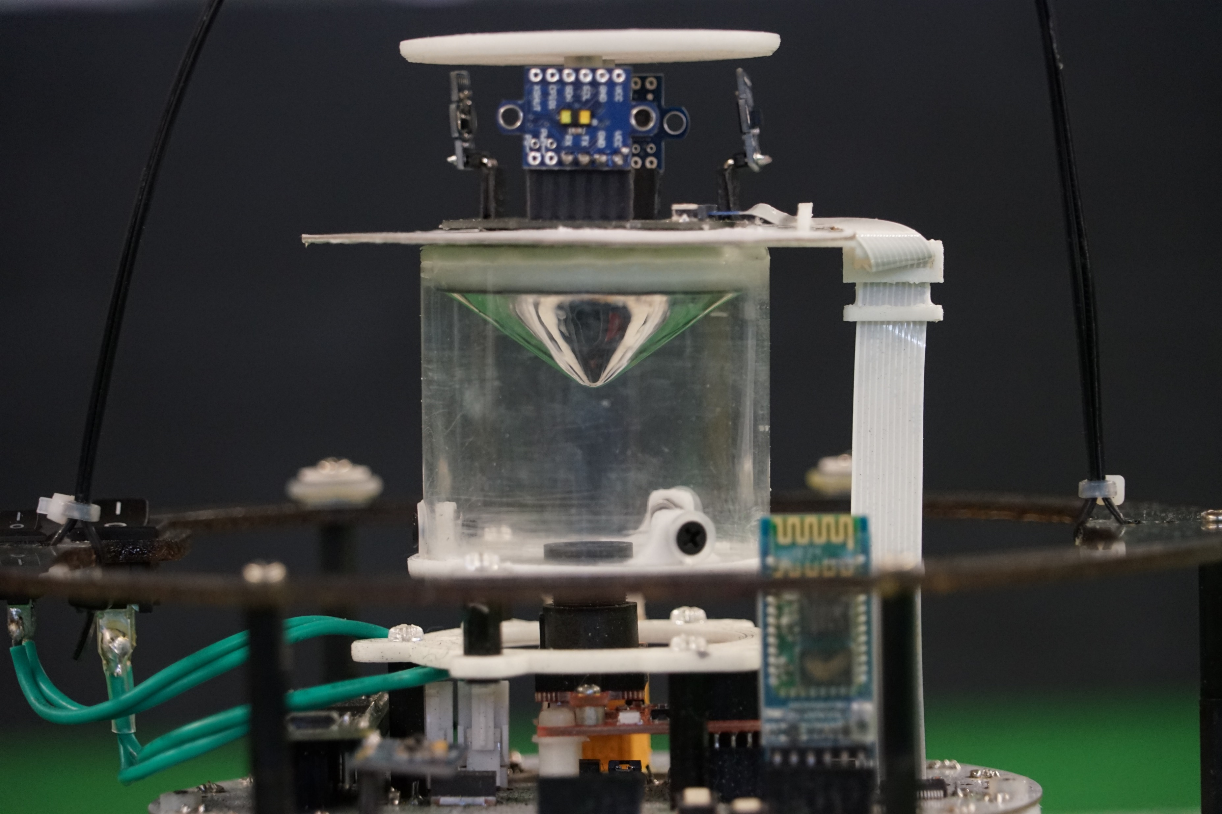
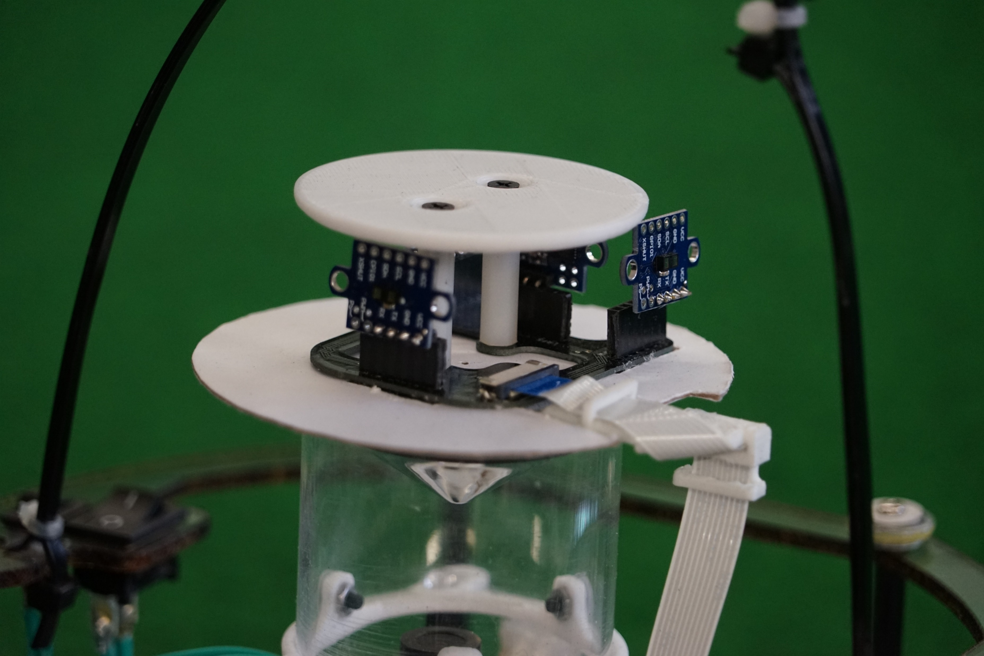
Innovative Mirror Mount (Novel Feature)
There are two mounts for the mirror
They allow the mirror to be centred for the camera’s field of view
This is needed since the centre of the lens is not necessarily the centre of the view for the camera
The mirror mount also includes a mount for the LRF PCB
This includes a part where the Flat Flex Cable can wrap around so it is orientated in a way where it won’t affect the camera
Notes:
Matthew

Slide 7
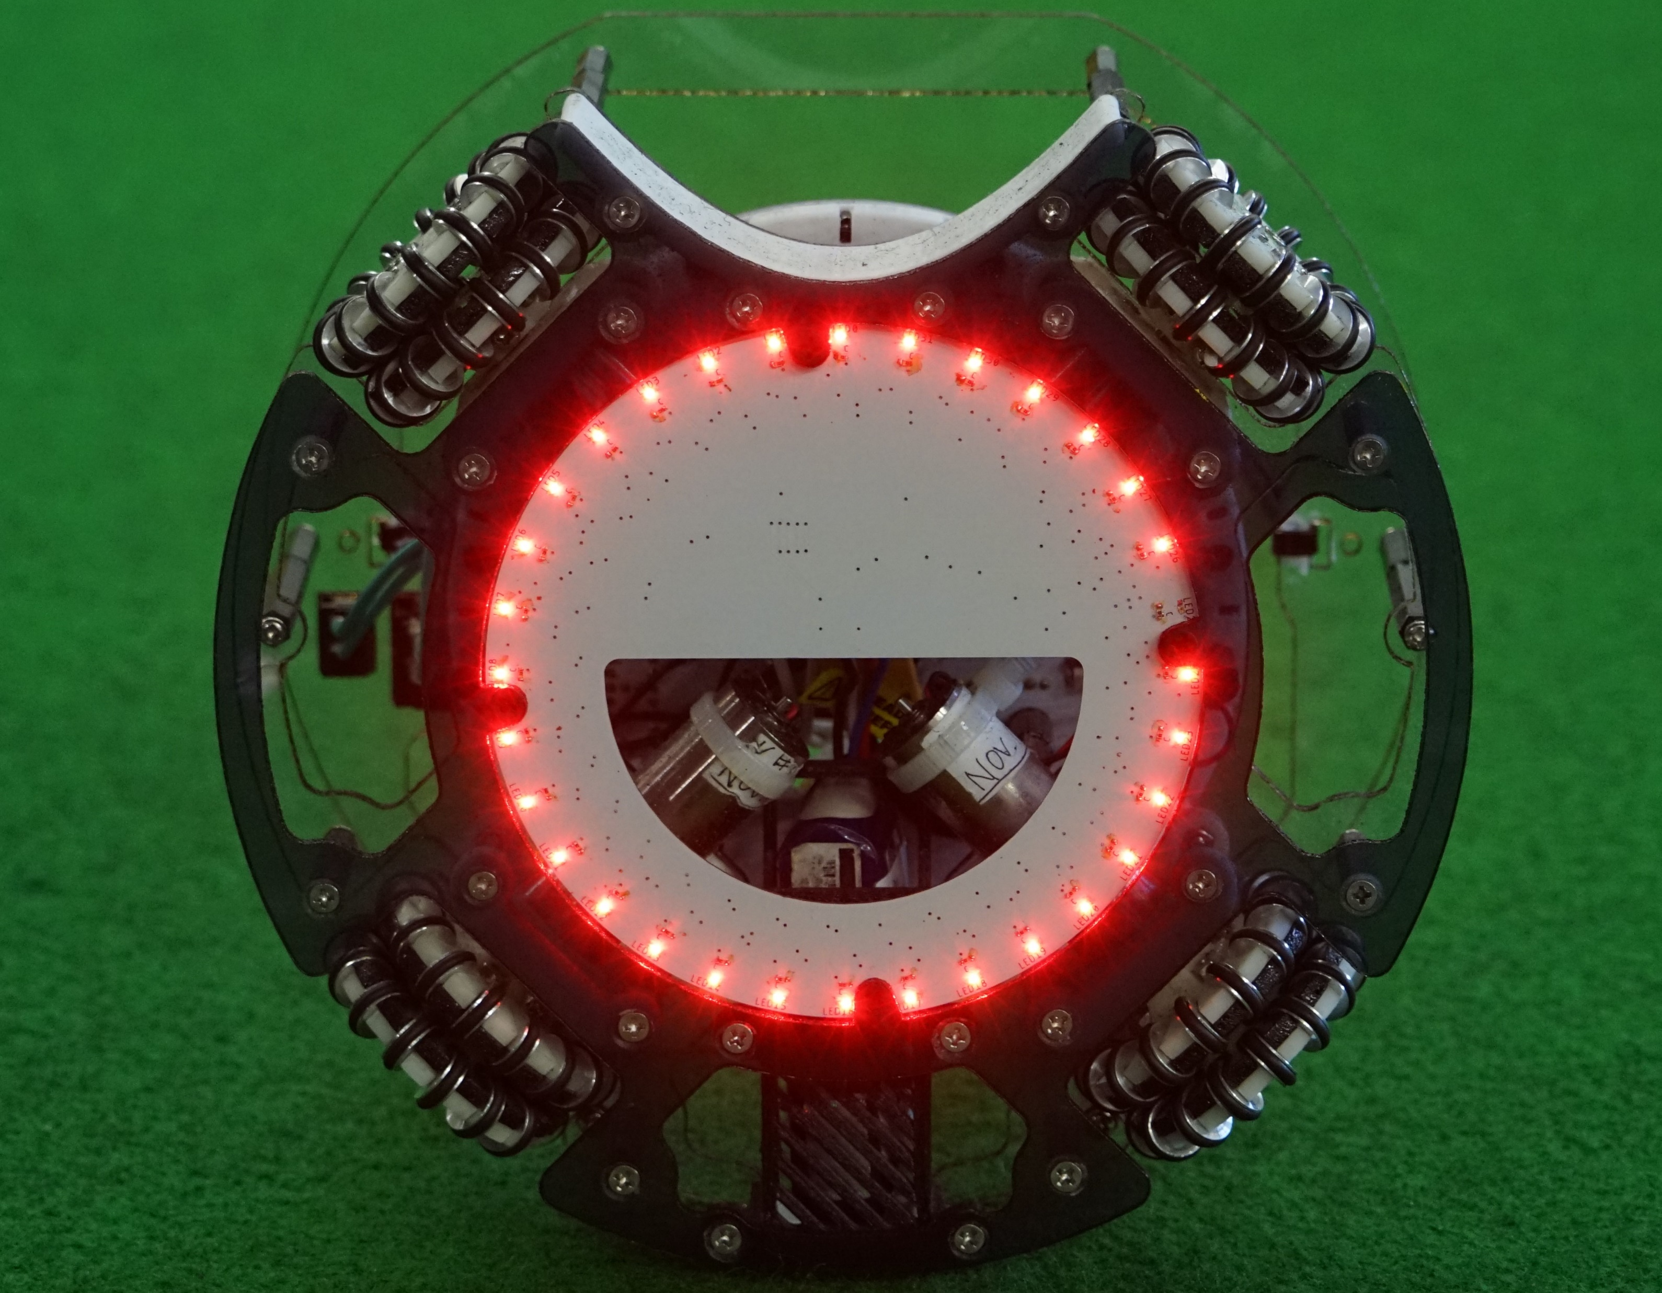
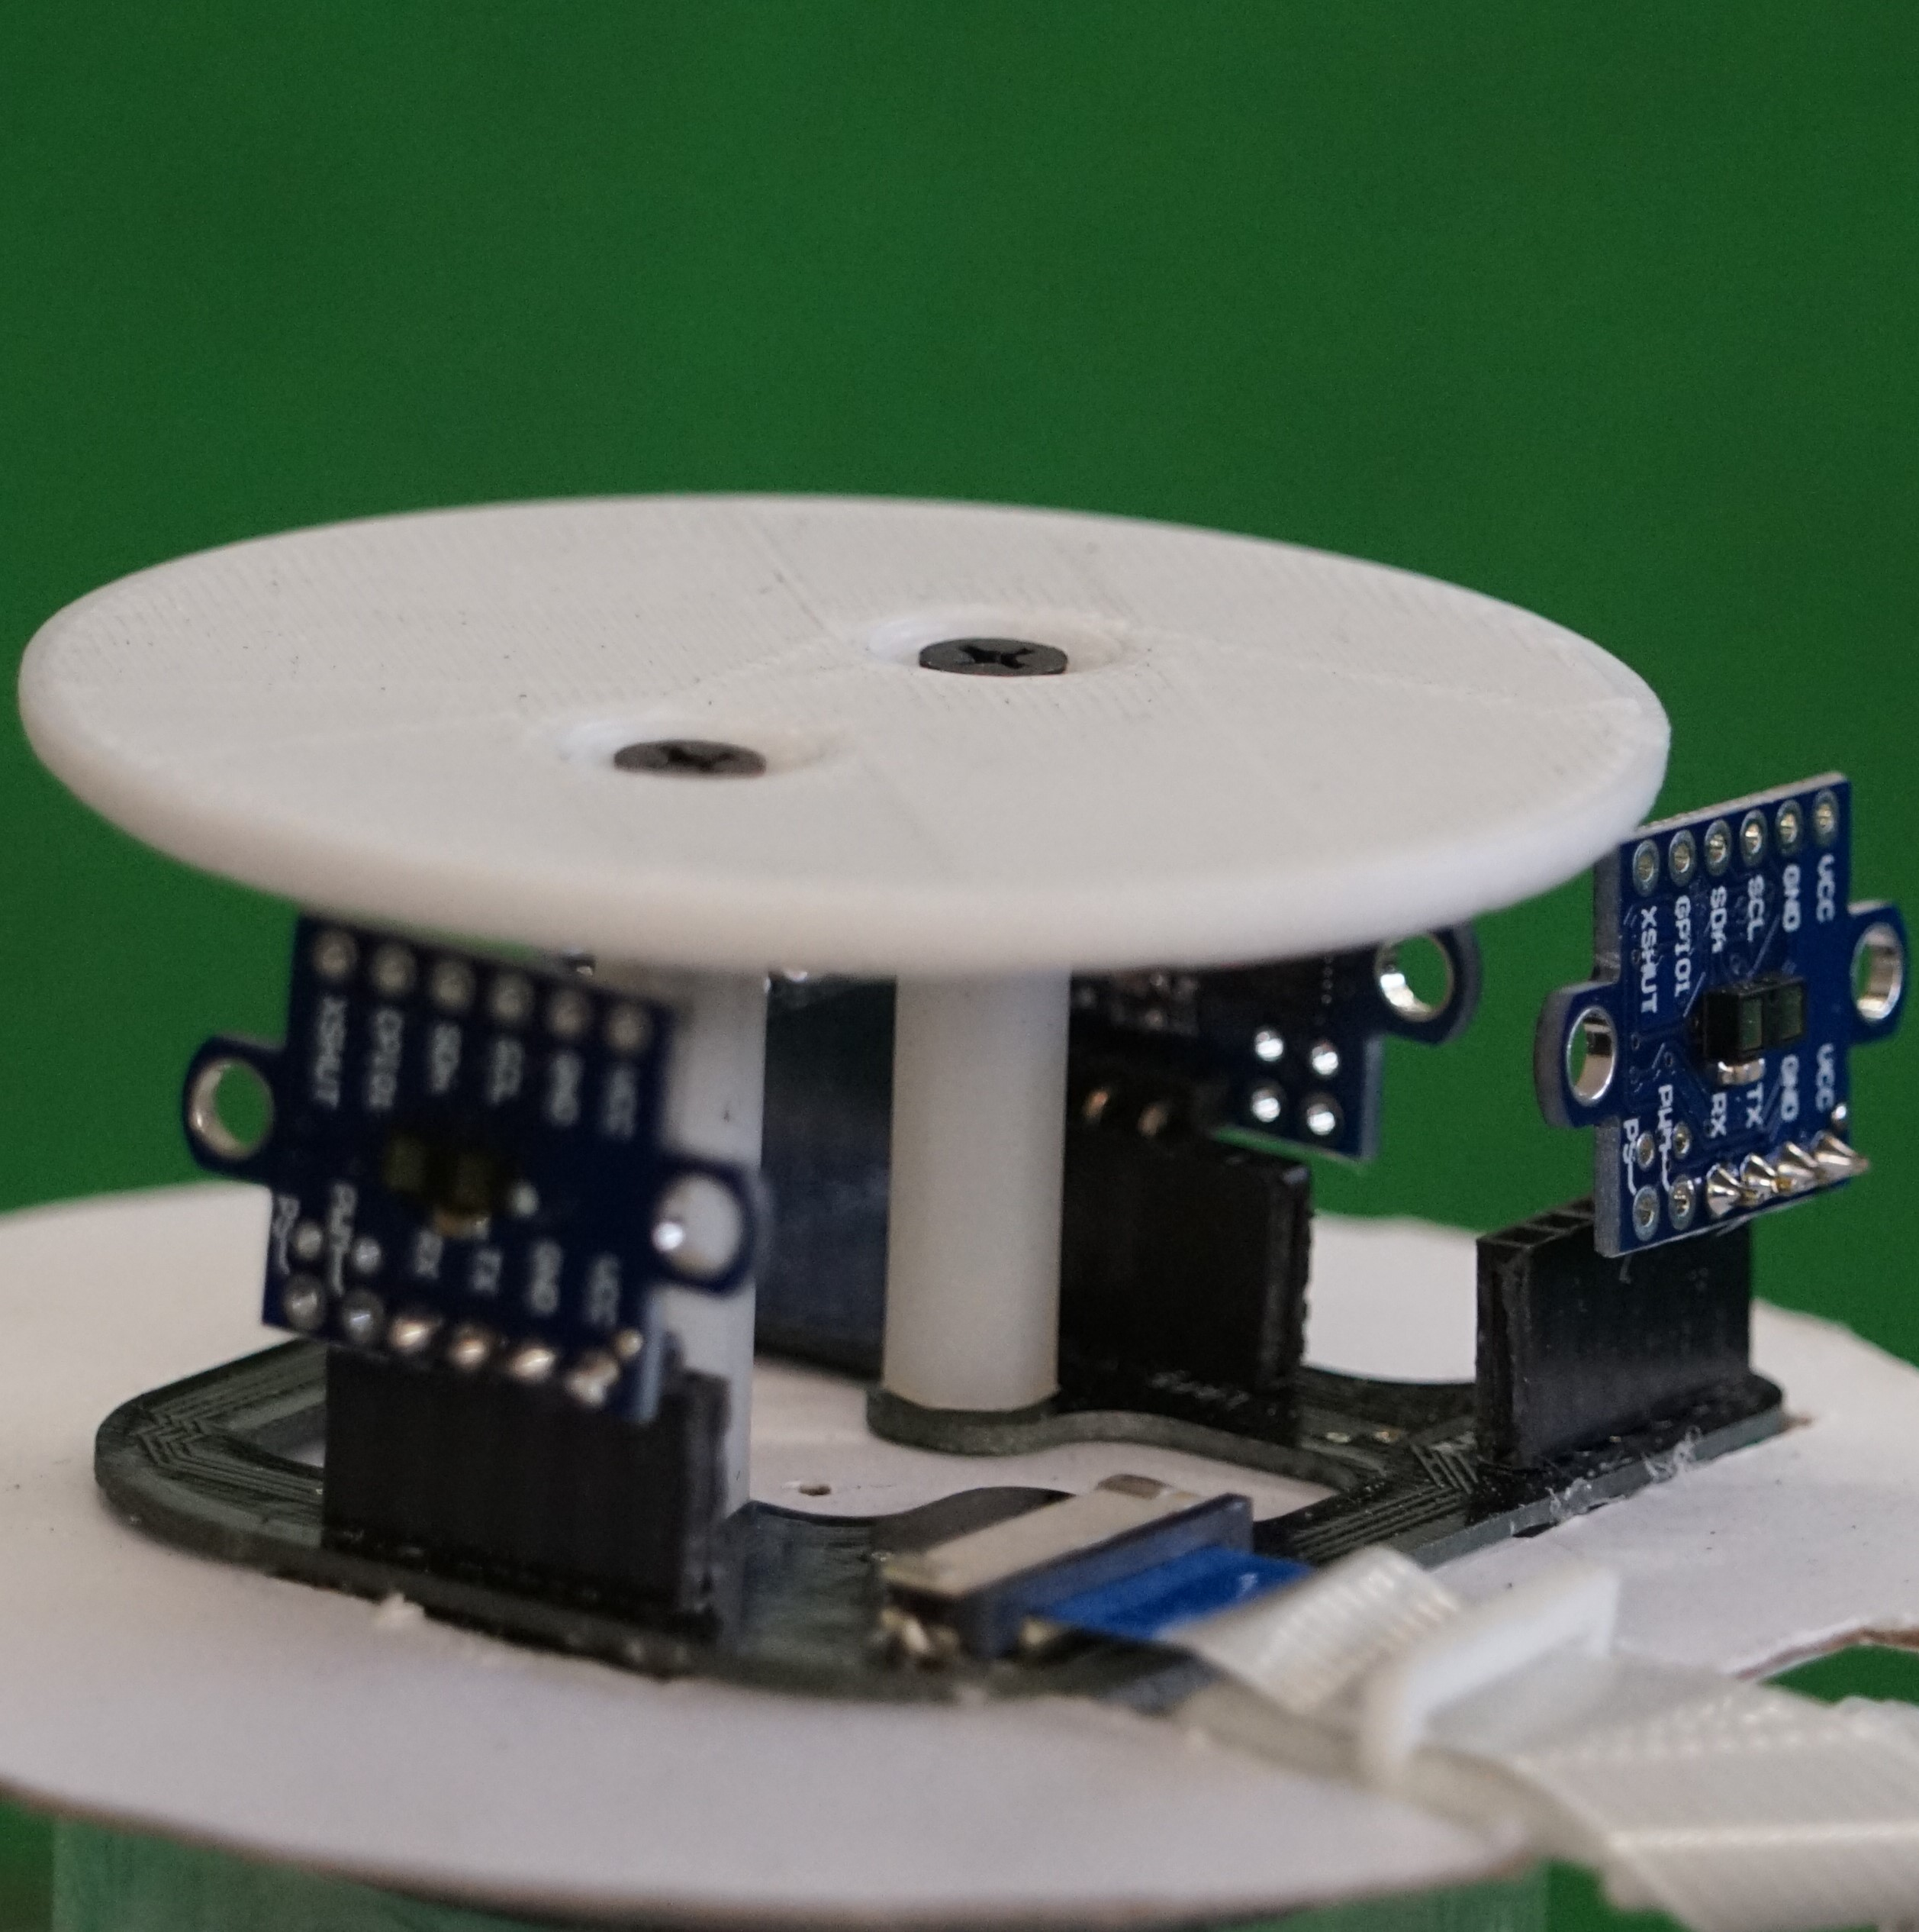
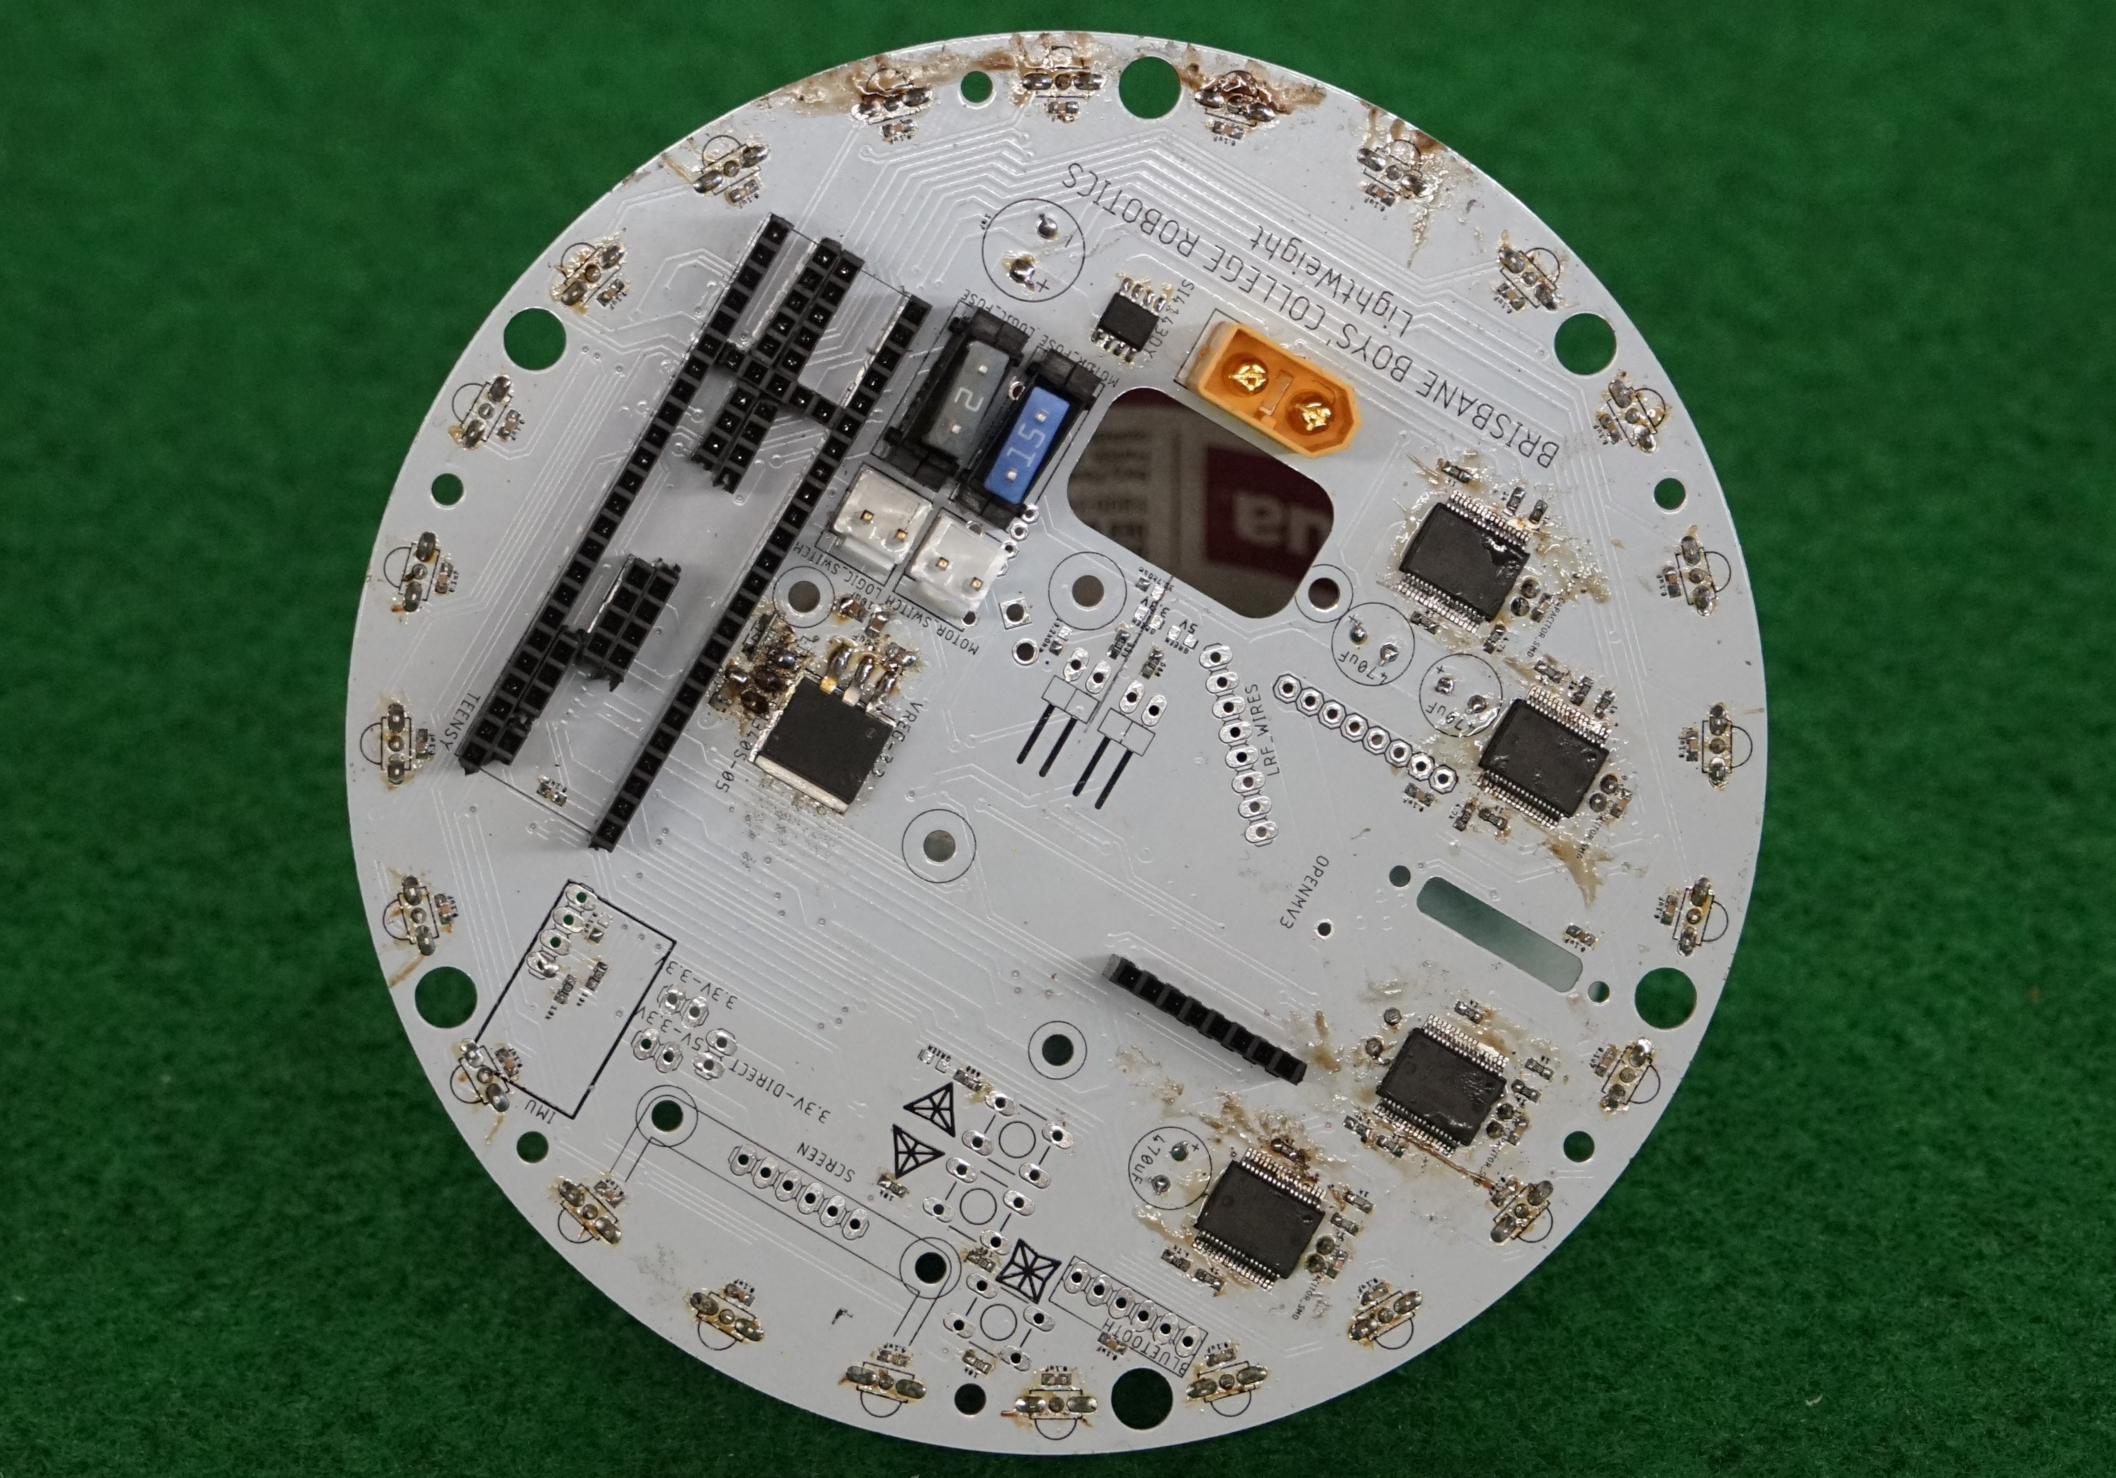
Reliability
Light Sensor PCB
LRF PCB
PCB’s reduce wire runs and risk of disconnection
Minimum amount of parts used
Reduces maintenance time
Reduced human error in construction
Simple microcontroller layout
Increases reliability on communication between controllers
Main PCB
Notes:
Gus

Slide 8
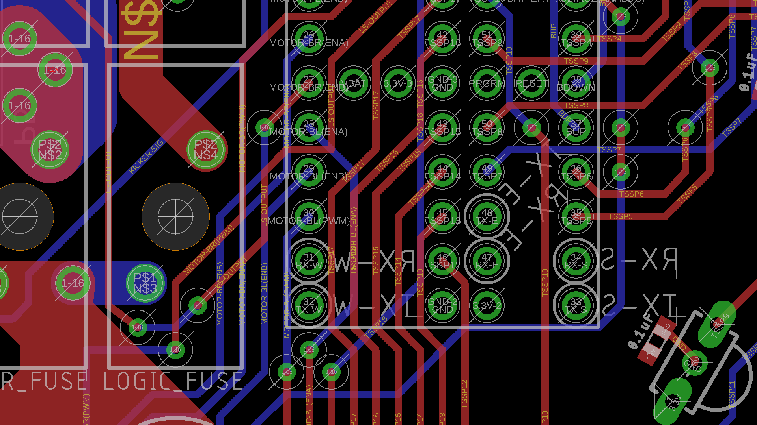
Use of Sensors
Notes:
Matthew

Slide 9
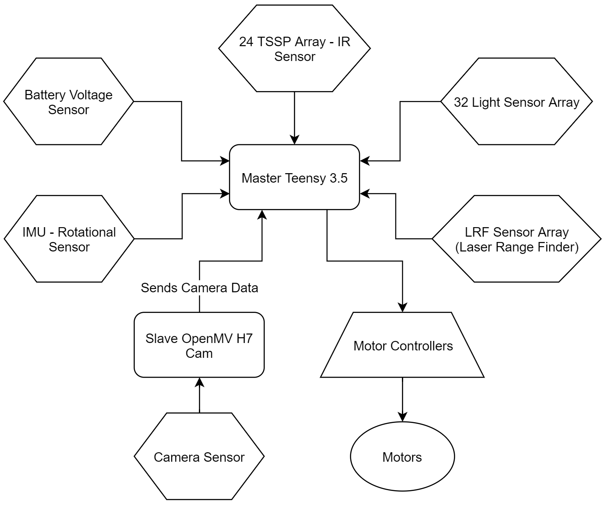
Overview
The Sensors are arranged on the three PCBs
The Robot has two micro-controllers
The diagram on the right shows how the components on the robot interact
Teensy 3.5
Receives data from the robot’s sensors
Calculates movement directions and heading
Gives command to the robot’s four motors
OpenMV H7
Receives data from the image sensor
Recognises areas of colour as ‘blobs’
Converts blob data to usable angles
Notes:
Taehwan

Slide 10
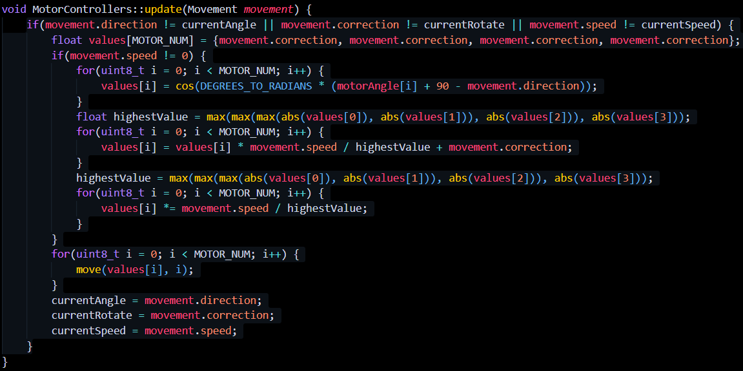
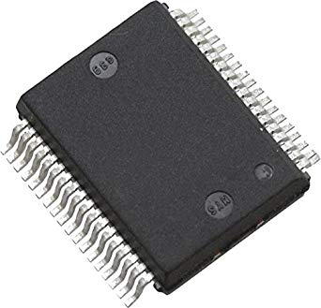
Motor Control
Each motor requires 1 VNH5050 Motor Controller
Each controller requires 2 digital signals and 1 Pulse Width Modulation (PWM) signal
The Teensy 3.5 calculates the value of the PWM signal using a cosine function
The controller then receives these values from the Teensy 3.5
This alters the speed and direction at which the motors spin at, allowing the robot to move in all directions
Motor Controller code
Motor Controller Chip
Notes:
Matthew

Slide 11
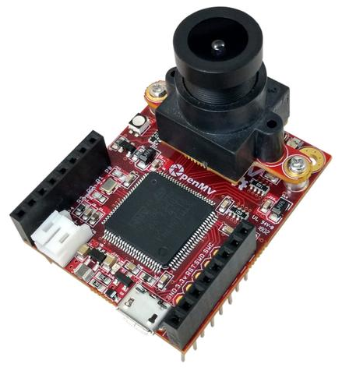
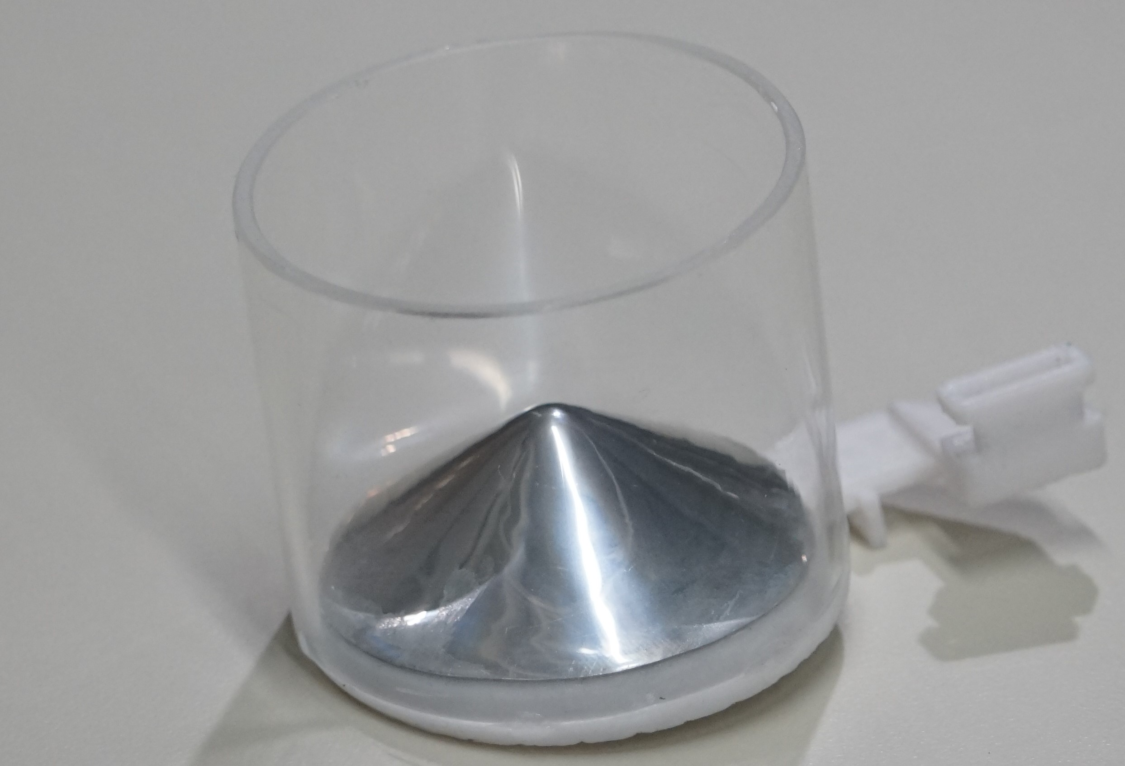
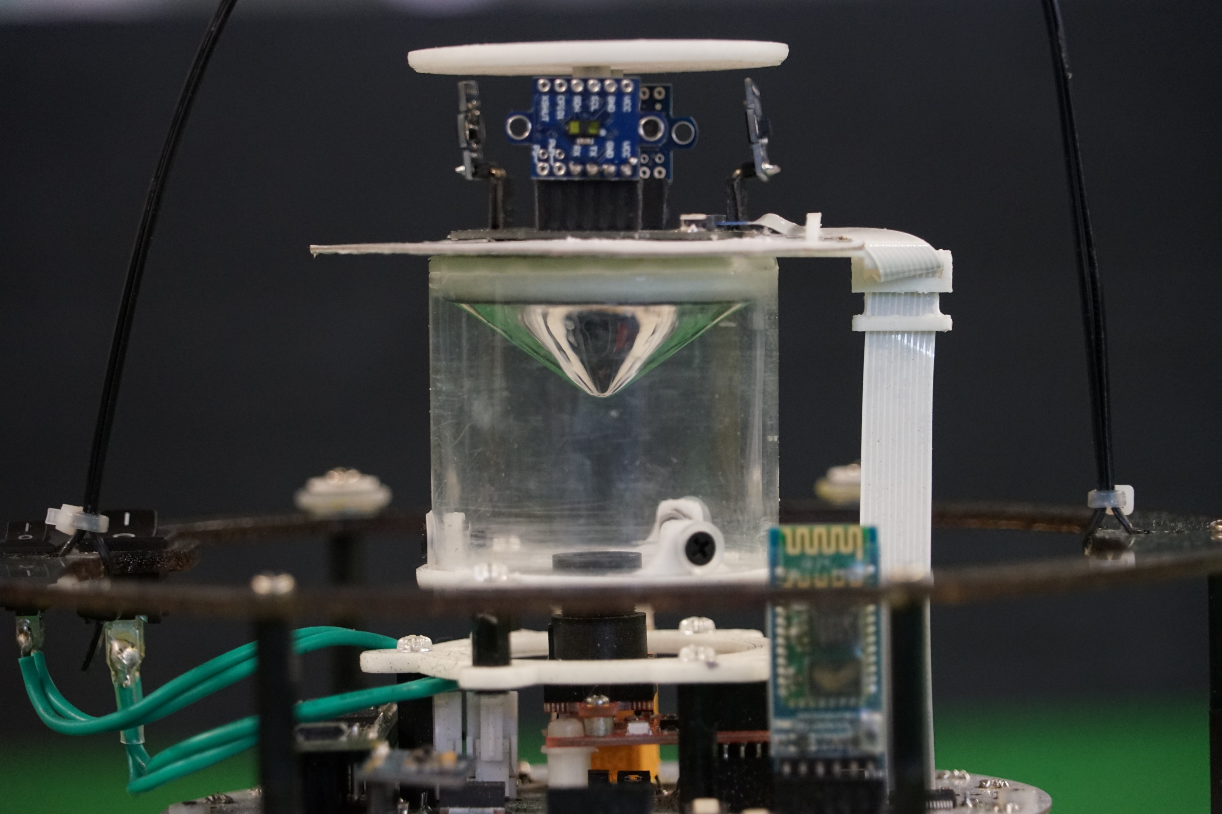
Computer Vision
The OpenMV is an optical sensor with a focusable lens
This is used in conjunction with a vertically mounted custom-made convex mirror, allowing for the robot to have a 360 degrees view
The mirrors were made using a vacuum-forming production process
The robot also centres on the field when it can’t see the ball by using the camera
This means that the robot will accurately be able to centre since it is dependent on the goals and the other robots don’t interfere the camera calculations
OpenMV H7
Acrylic Tube and Custom Mirror
Camera Assembly
Notes:
Gus

Slide 12
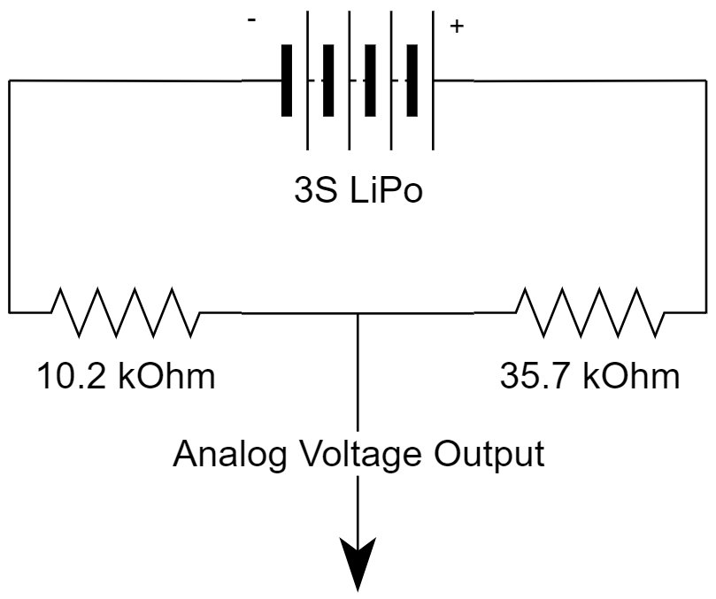
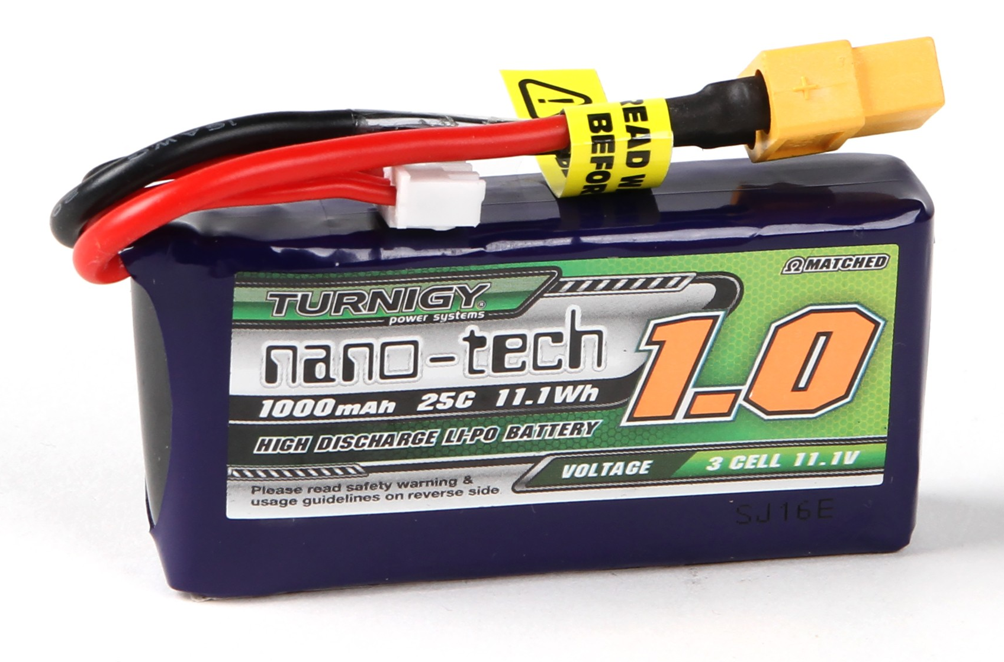
Battery Voltage Metrics
Battery voltage goes through a divider
The ratio of the divider is determined by the resistor values
Supplies Teensy 3.5 with an analog input in the range of 0 - 3.3V
This allows the robot to warn us when the battery is low
Reduces the risk of draining the battery past its charge point
Increases the longevity of the batteries
Voltage Divider Schematic
1000mAh 3 Cell LIPO Battery
Notes:
Matthew

Slide 13
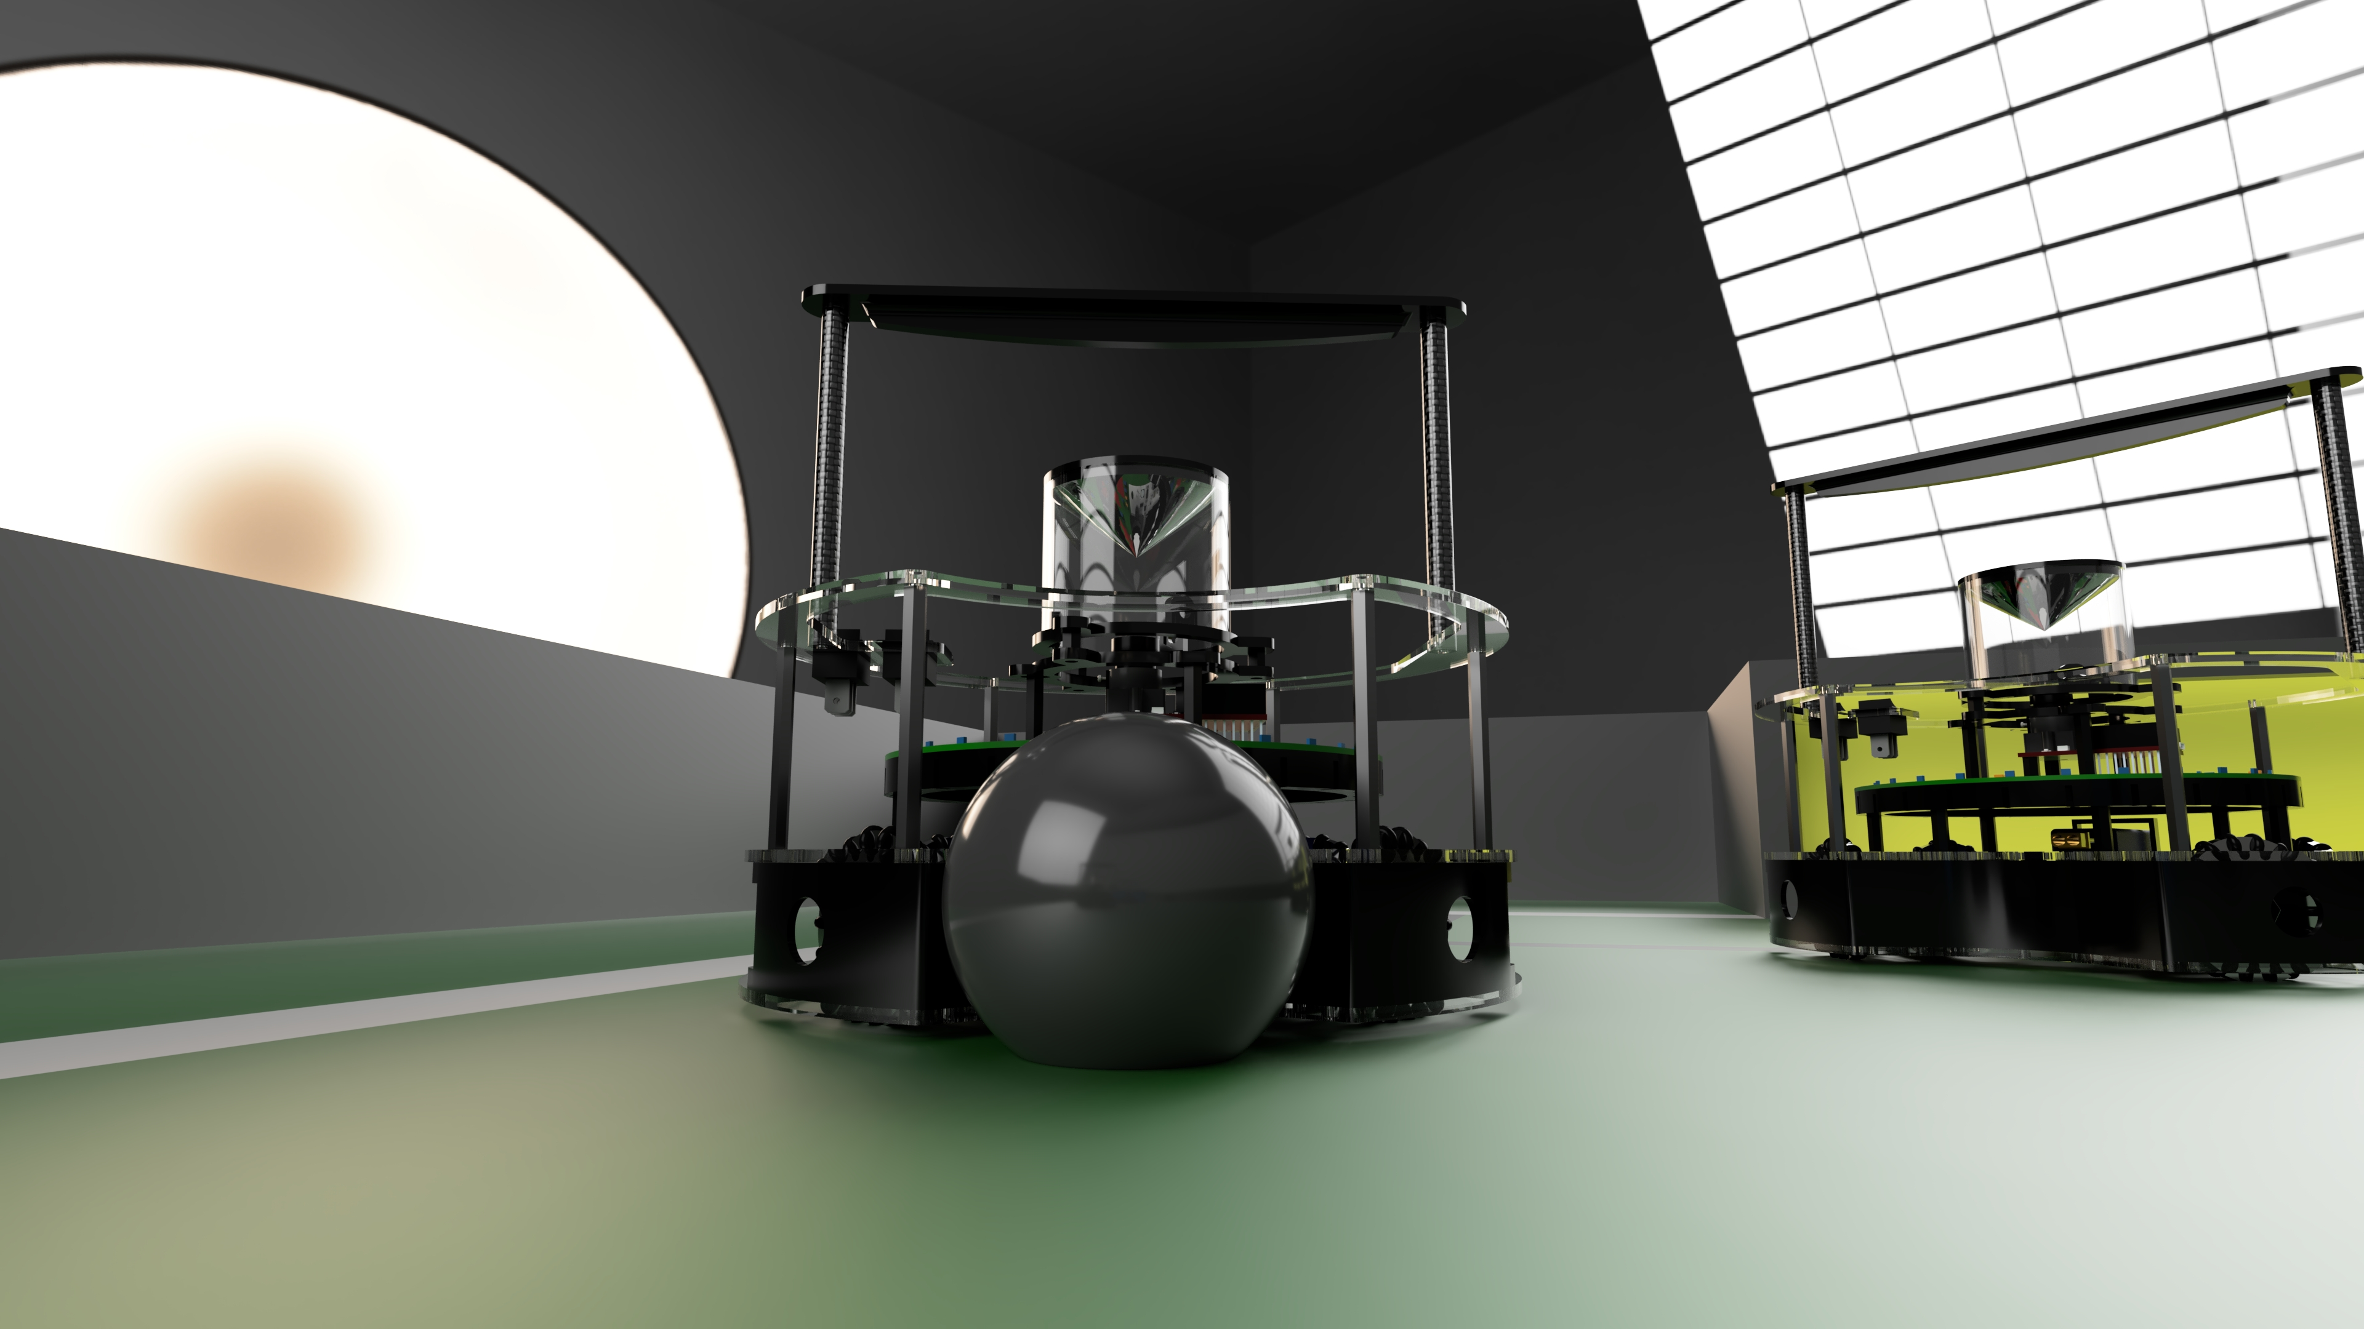
Game Strategy
Notes:
Aparaj

Slide 14
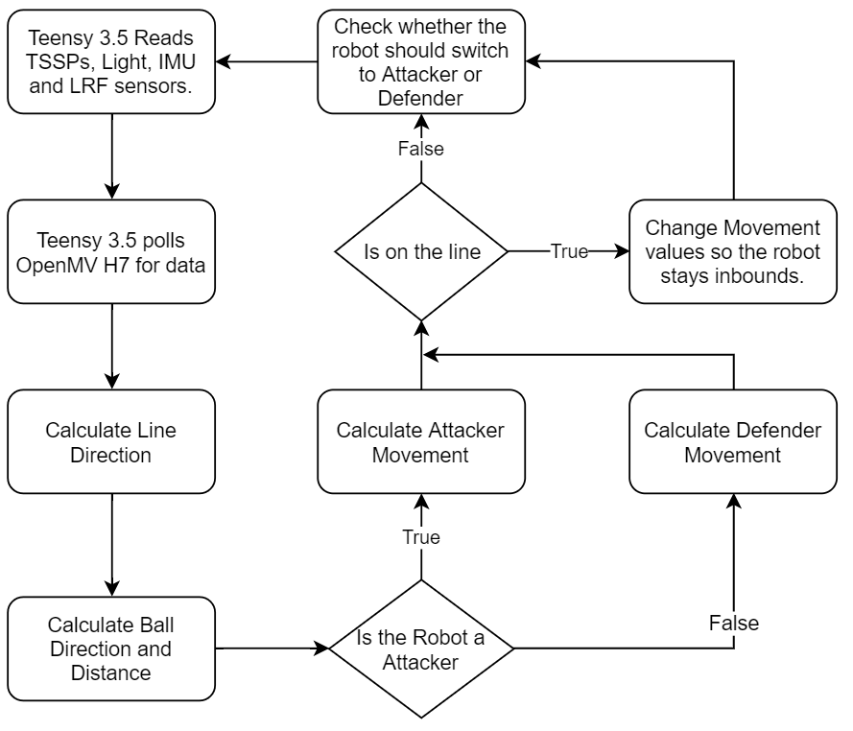
Overview
The robots first read all of the sensors
It then uses the data from these sensors to calculate the optimal movement direction
The diagram on the right shows the logic process of the robot
There are multiple aspects of our game strategy which will be covered next
Robot Logic
Notes:
Gus

Slide 15
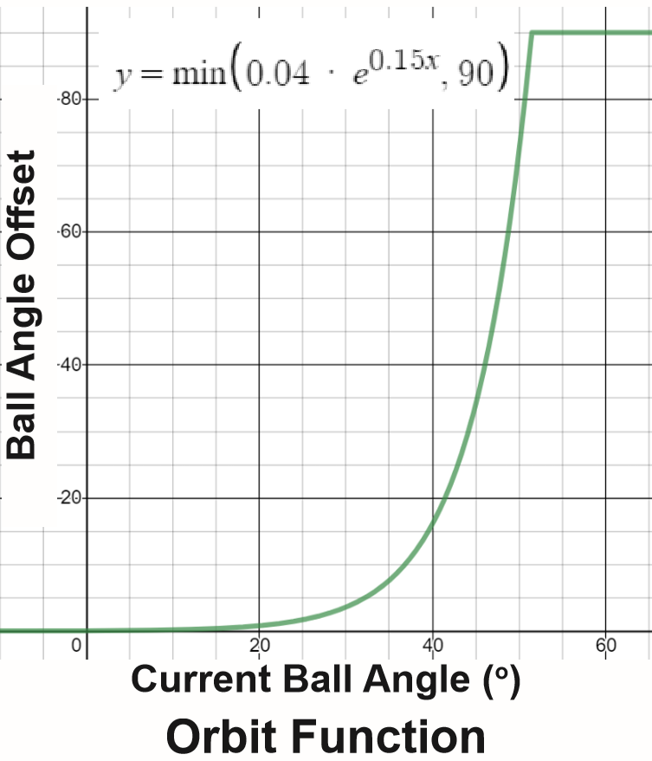
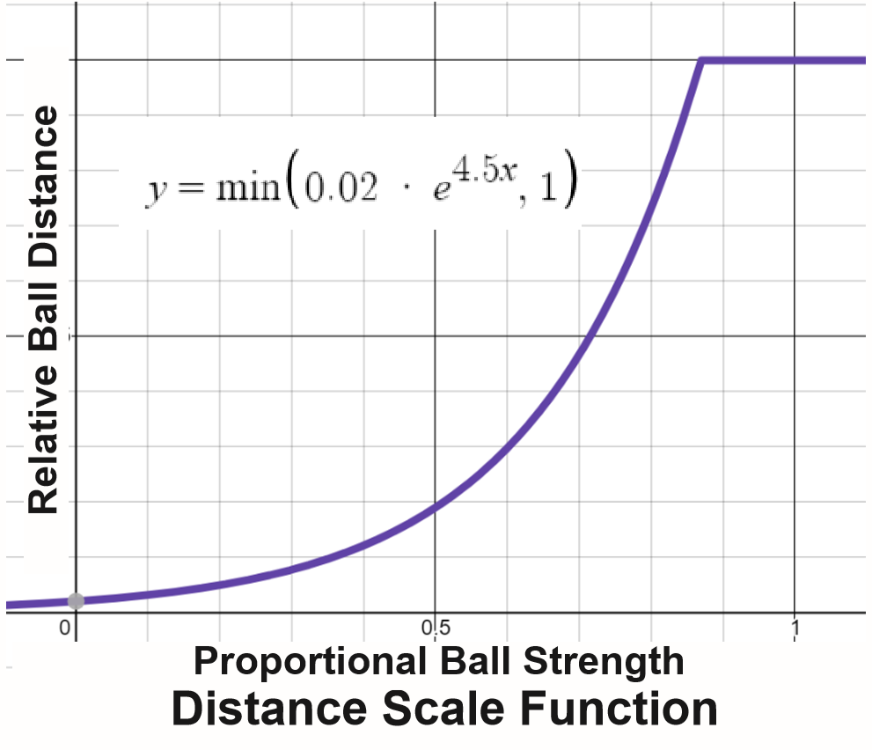
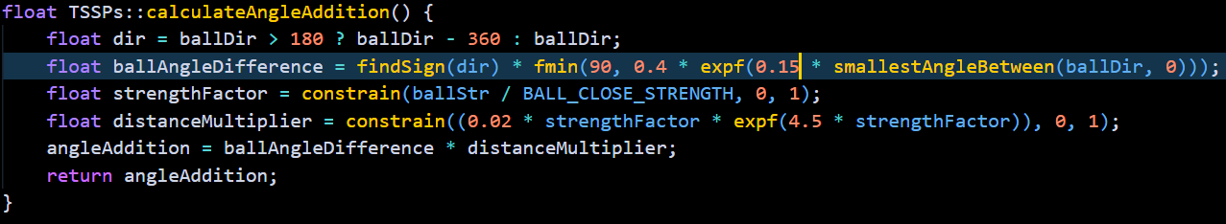
Ball Following
To follow the ball the robot has to first orbit around the ball
The orbit includes two exponential functions that intuitively calculate the attacker movement value.
The first function calculates the ball angle offset based on the current ball angle
The second function calculates the relative ball distance based on the TSSP proportional ball strength
Orbit Calculate Code
Notes:
Aparaj

Slide 16
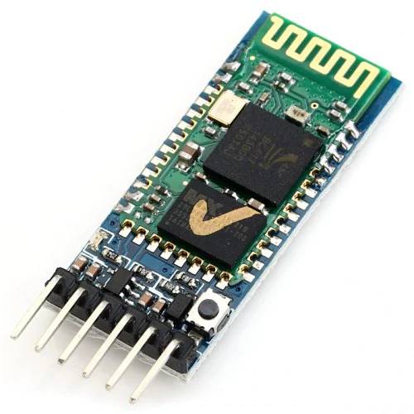
Bluetooth Communication and Dynamic Switching
HC-05 Bluetooth Modules are utilised to allow communication between robots
The robots have two roles: attacker and defender
The robots send data to each other and based on those values, it would switch roles
This means that in gameplay, if one of the robots is taken off for damaged, the other robot will become a defender
HC-05 Bluetooth Module
Notes:
Taehwan

Slide 17
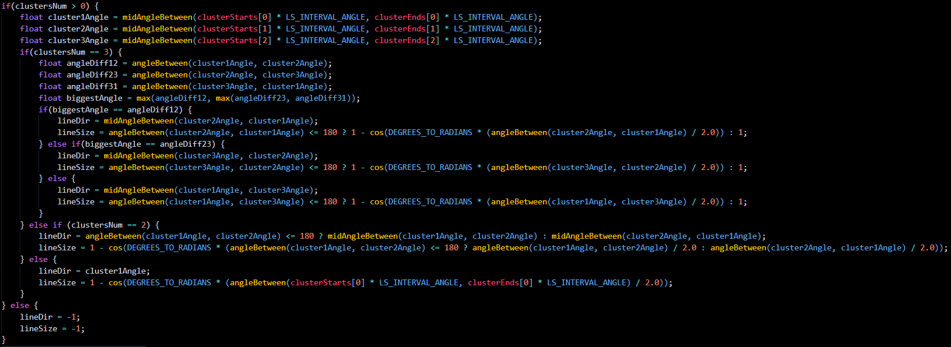
Line Avoidance
To avoid the line, the robot first identifies clusters of light sensors that can detect the line
The clusters are used to calculate the line direction and line size
The line size determines how far the robot is over the line
Line direction and size calculations
Notes:
Aparaj

Slide 18
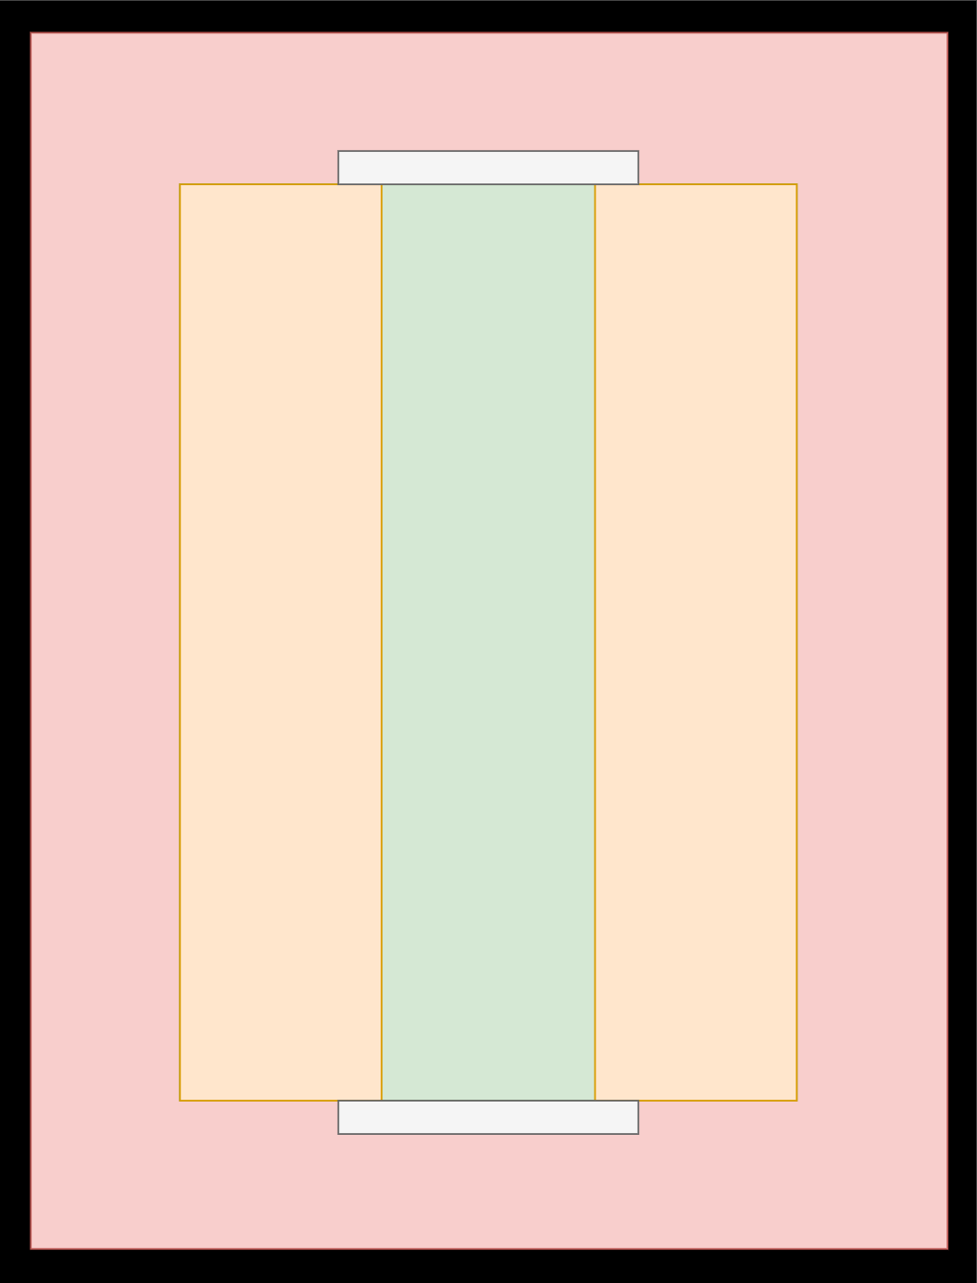
Light and LRF Sensor Fusion (Novel Feature)
LRF’s provide the robot with its distance to the wall
These distances are used in collaboration with the Light Sensors to help the robot stay in bounds
The LRFs are able to predict the robot going out
This reduces the chance of the robot going out
Slow Area
Normal Area
Slow Area
LRF PCB
LRF Avoidance Pre-empting
Notes:
Matthew

Slide 19

Heading Calculations
The robot has an MPU9250 which acts as a gyroscope sensor
This sensor outputs the degrees per second (DPS) that the robot is moving at for three different axis
This DPS value is used to calculate the robots’ heading and enables the robot to always face the opposition
The OpenMV uses trigonometric functions to calculate the goal angle and distance for both goals
The goal angles and distance is used to tell the robot where to face so it can always point towards the attacking goal, or defend its own goal
The orientation values are controlled using a Proportional-Integral-Derivative (PID) controller
MPU9250
Camera Assembly
Goal Angle and Distance Calculations
Notes:
Aparaj

Slide 20
Problem Solving
Notes:
Taehwan

Slide 21
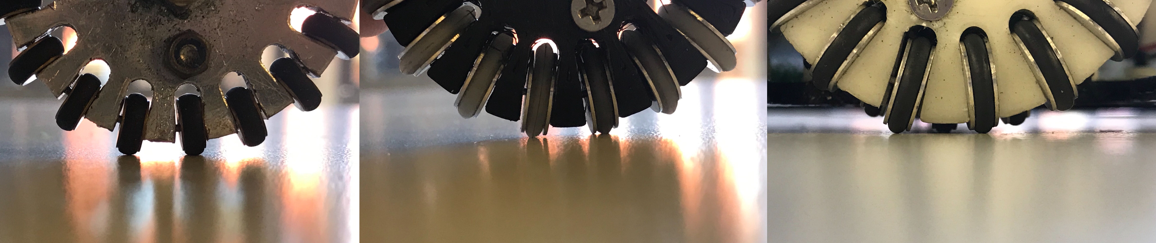
Line Avoidance
A major issue with the robot is that the motors used on the robot were too fast for the robot to stay in bounds
We first increased contact with the floor so the robot could change direction faster
We then had to use LRFs to pre-emptively slow down to completely fix the issue
Slow Area
Normal Area
Slow Area
Wheel Progression – GTF Wheel, Single Layered Custom Wheel, Double Layered Custom Wheel (Left to Right)
LRF Avoidance Pre-empting
Notes:
Gus

Slide 22
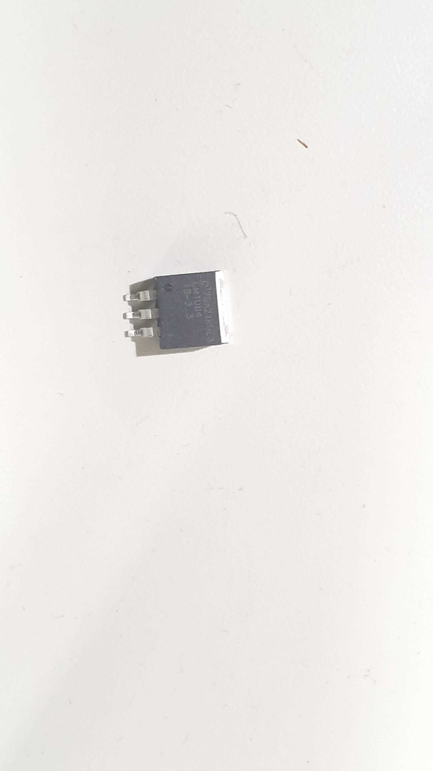
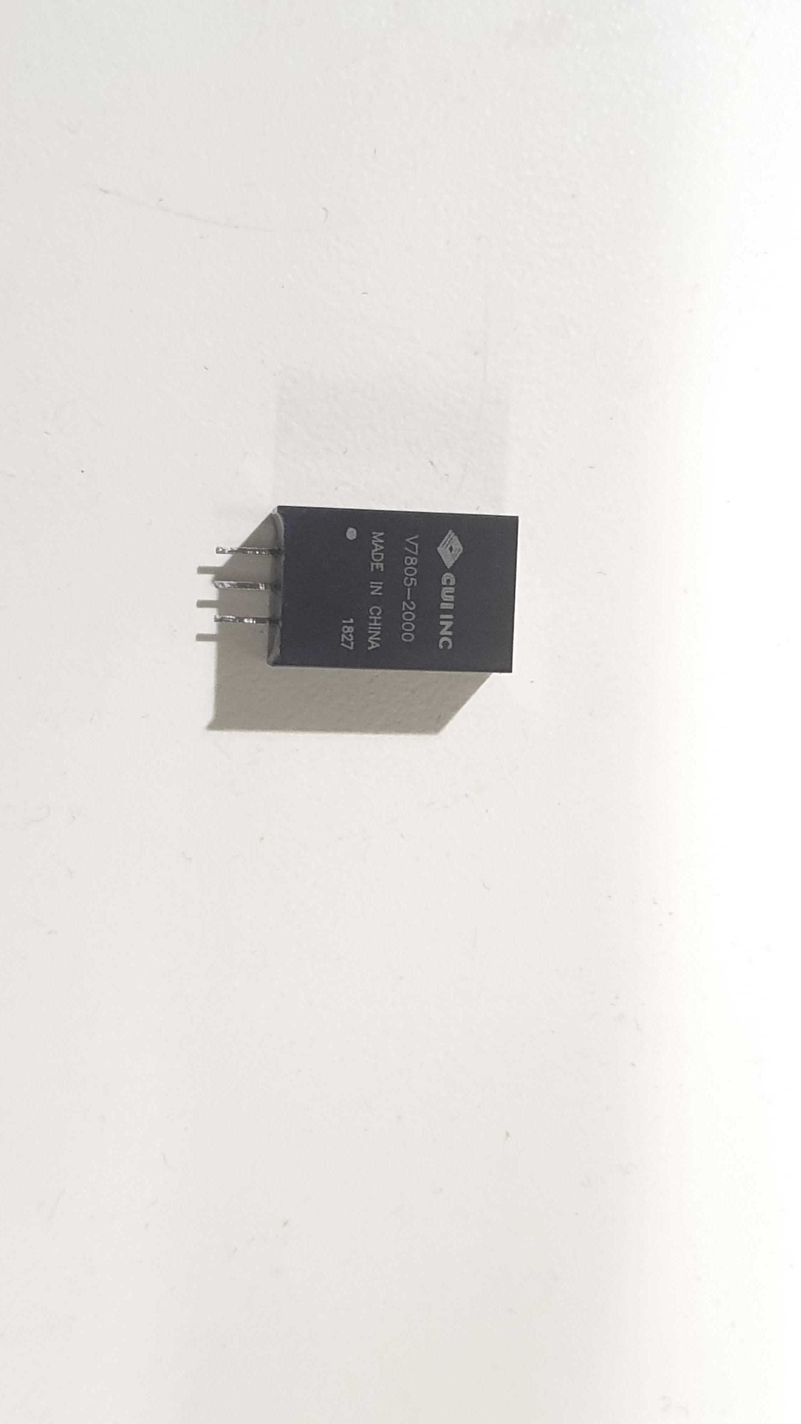
Power Supply
The original power supply had a single integrated circuit (IC) that could output 5V and 3.3V
This caused some issues as there was a problem with the IC
This was fixed by having two separate power supplies for the 5V and 3.3V
This meant that we had more components on the PCB, but all the components had power
3.3V Voltage Regulator
5V Voltage Regulator
Notes:
Matthew

Slide 23


Thank you
For more information about our robot, please visit https://bbcrobotics-mna.com/
Notes:
Gus

